Slide 2
Dataiku

Slide 3






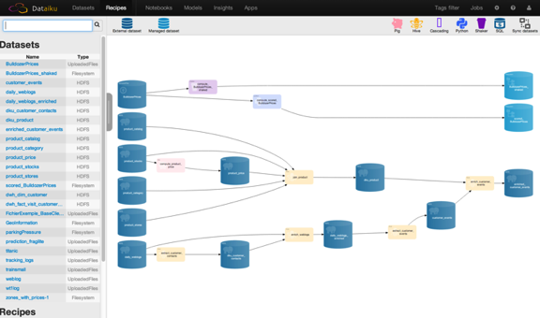
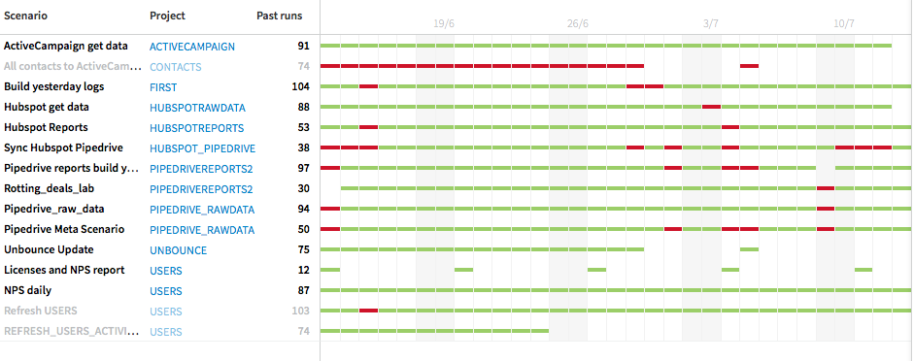
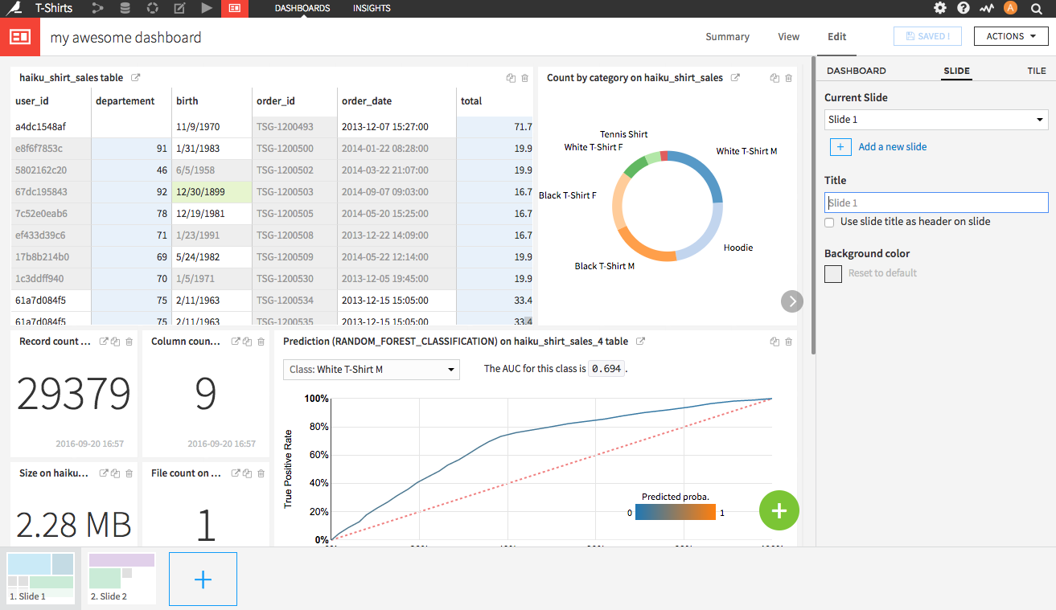
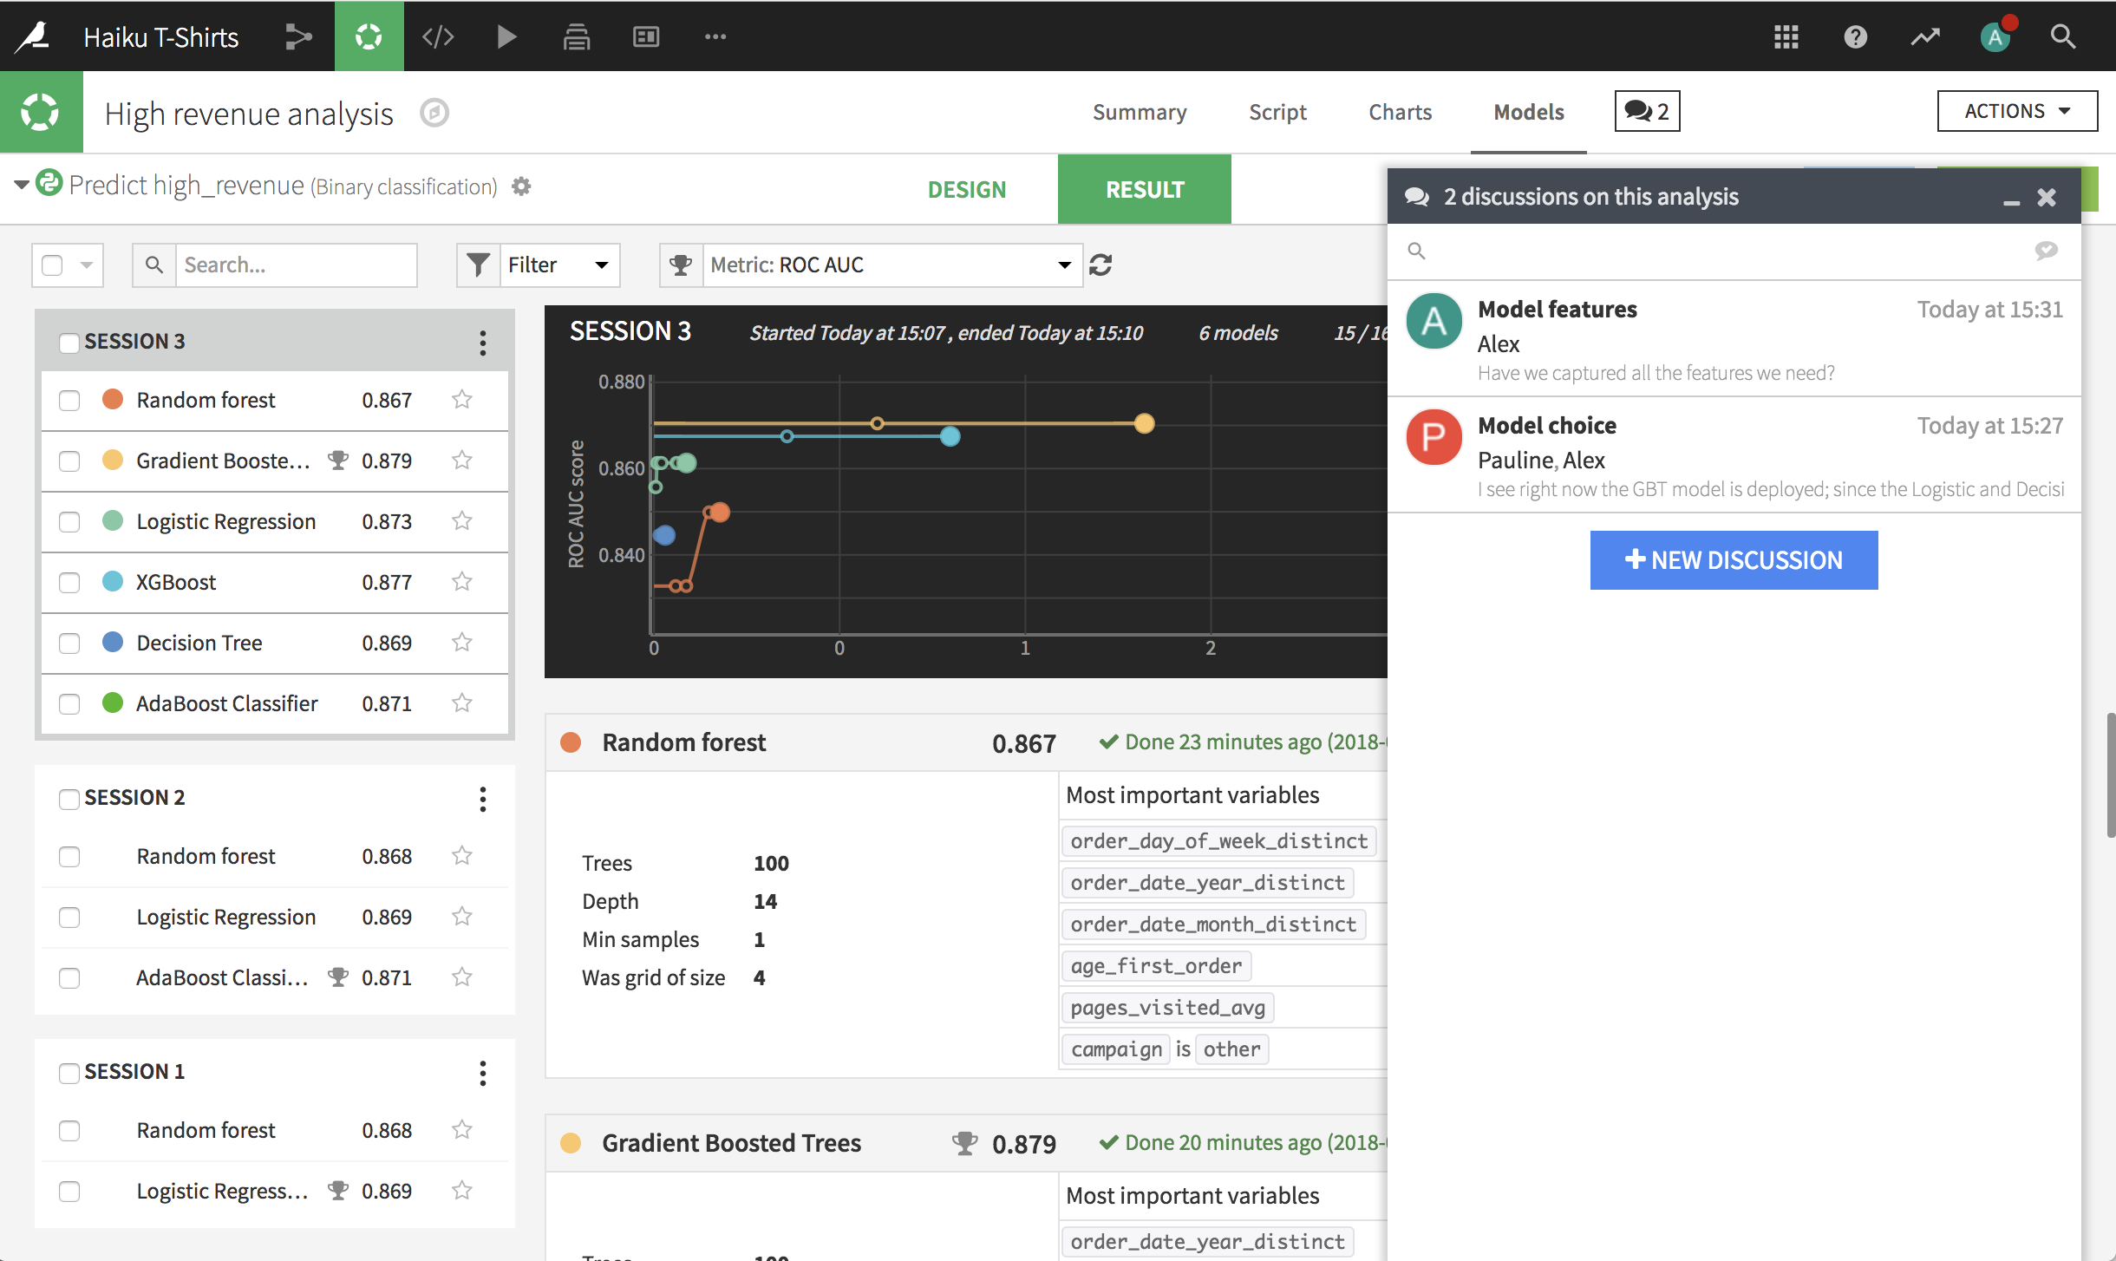
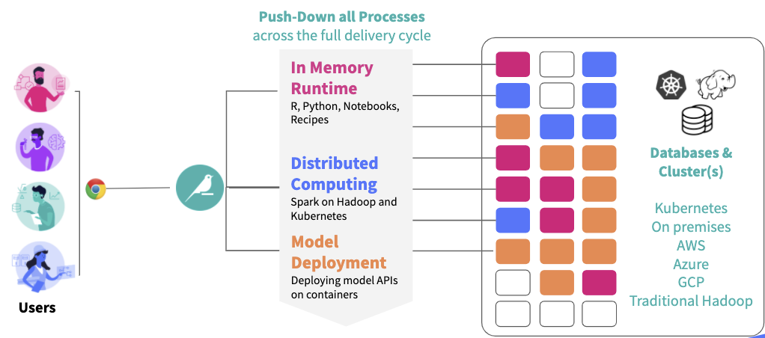
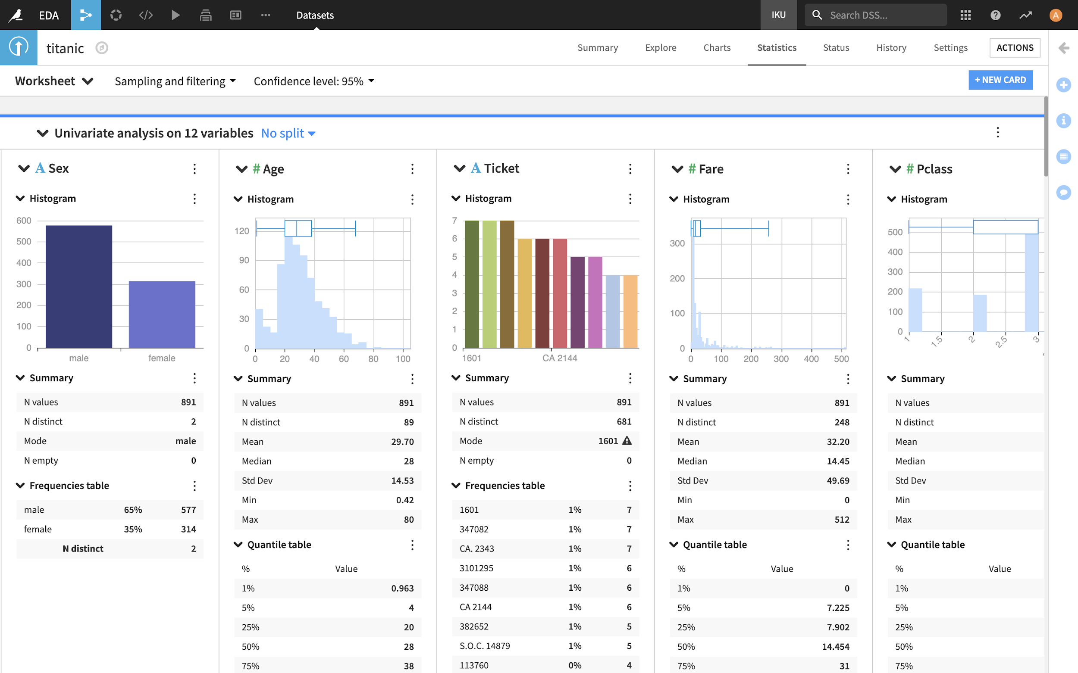
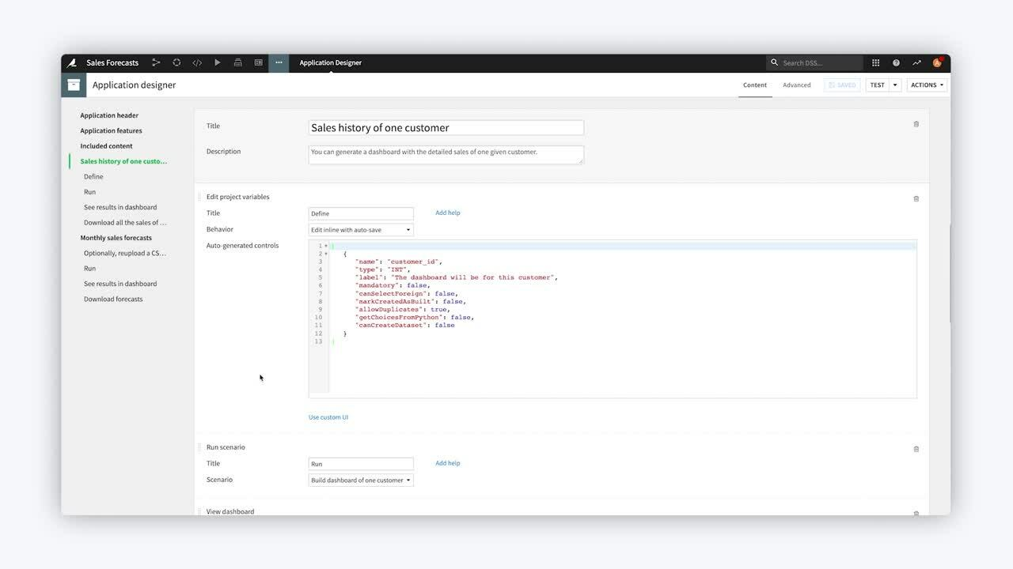
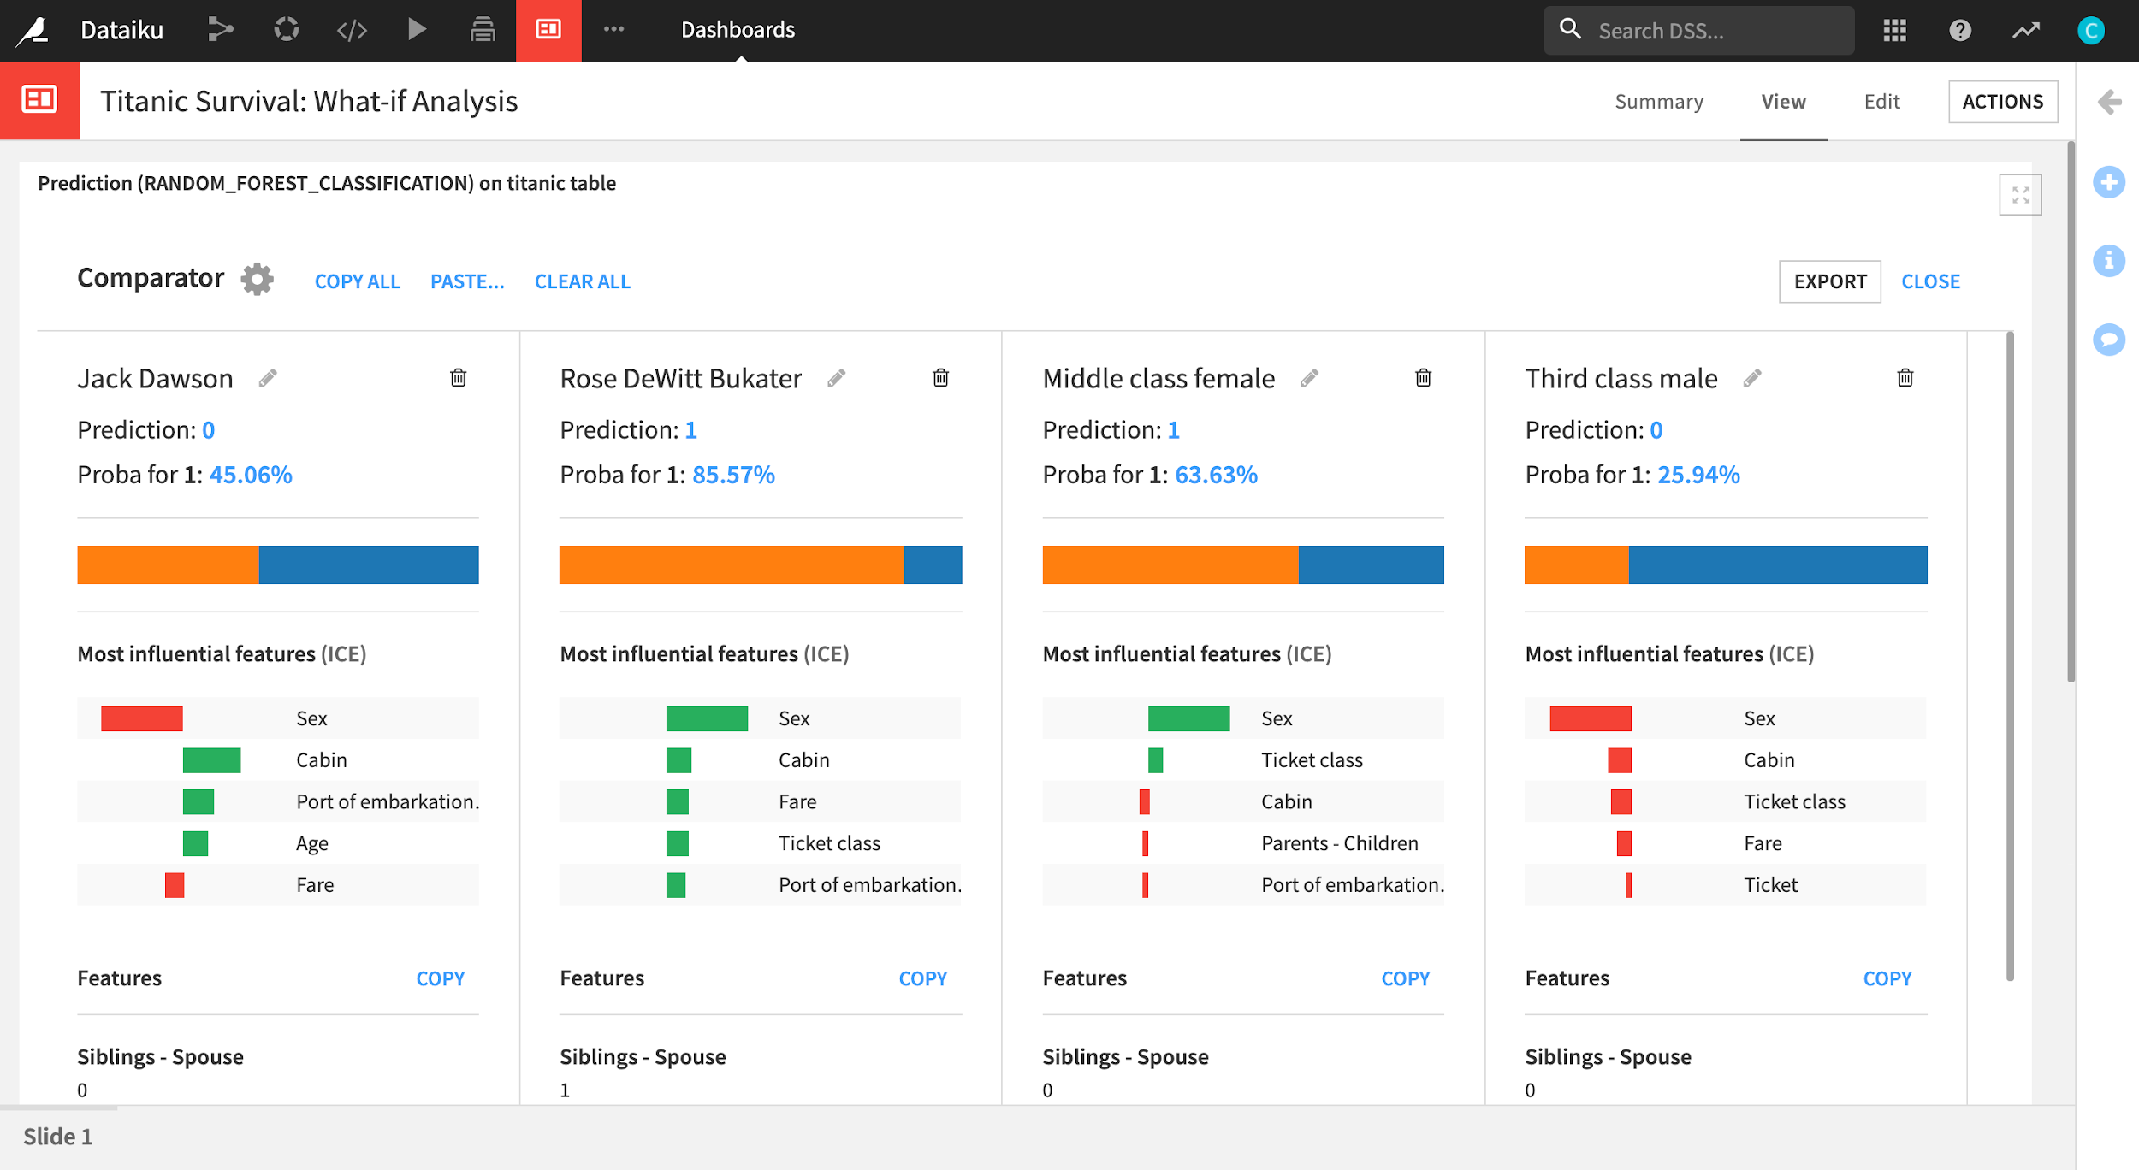
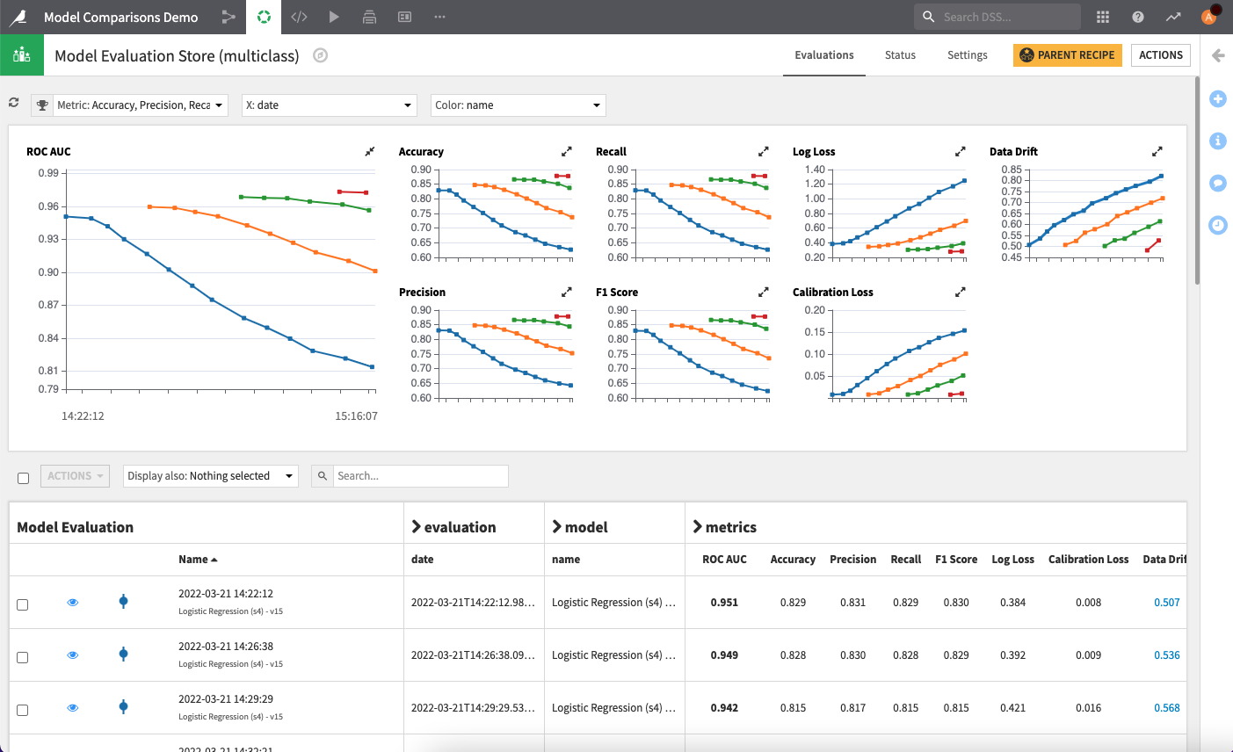
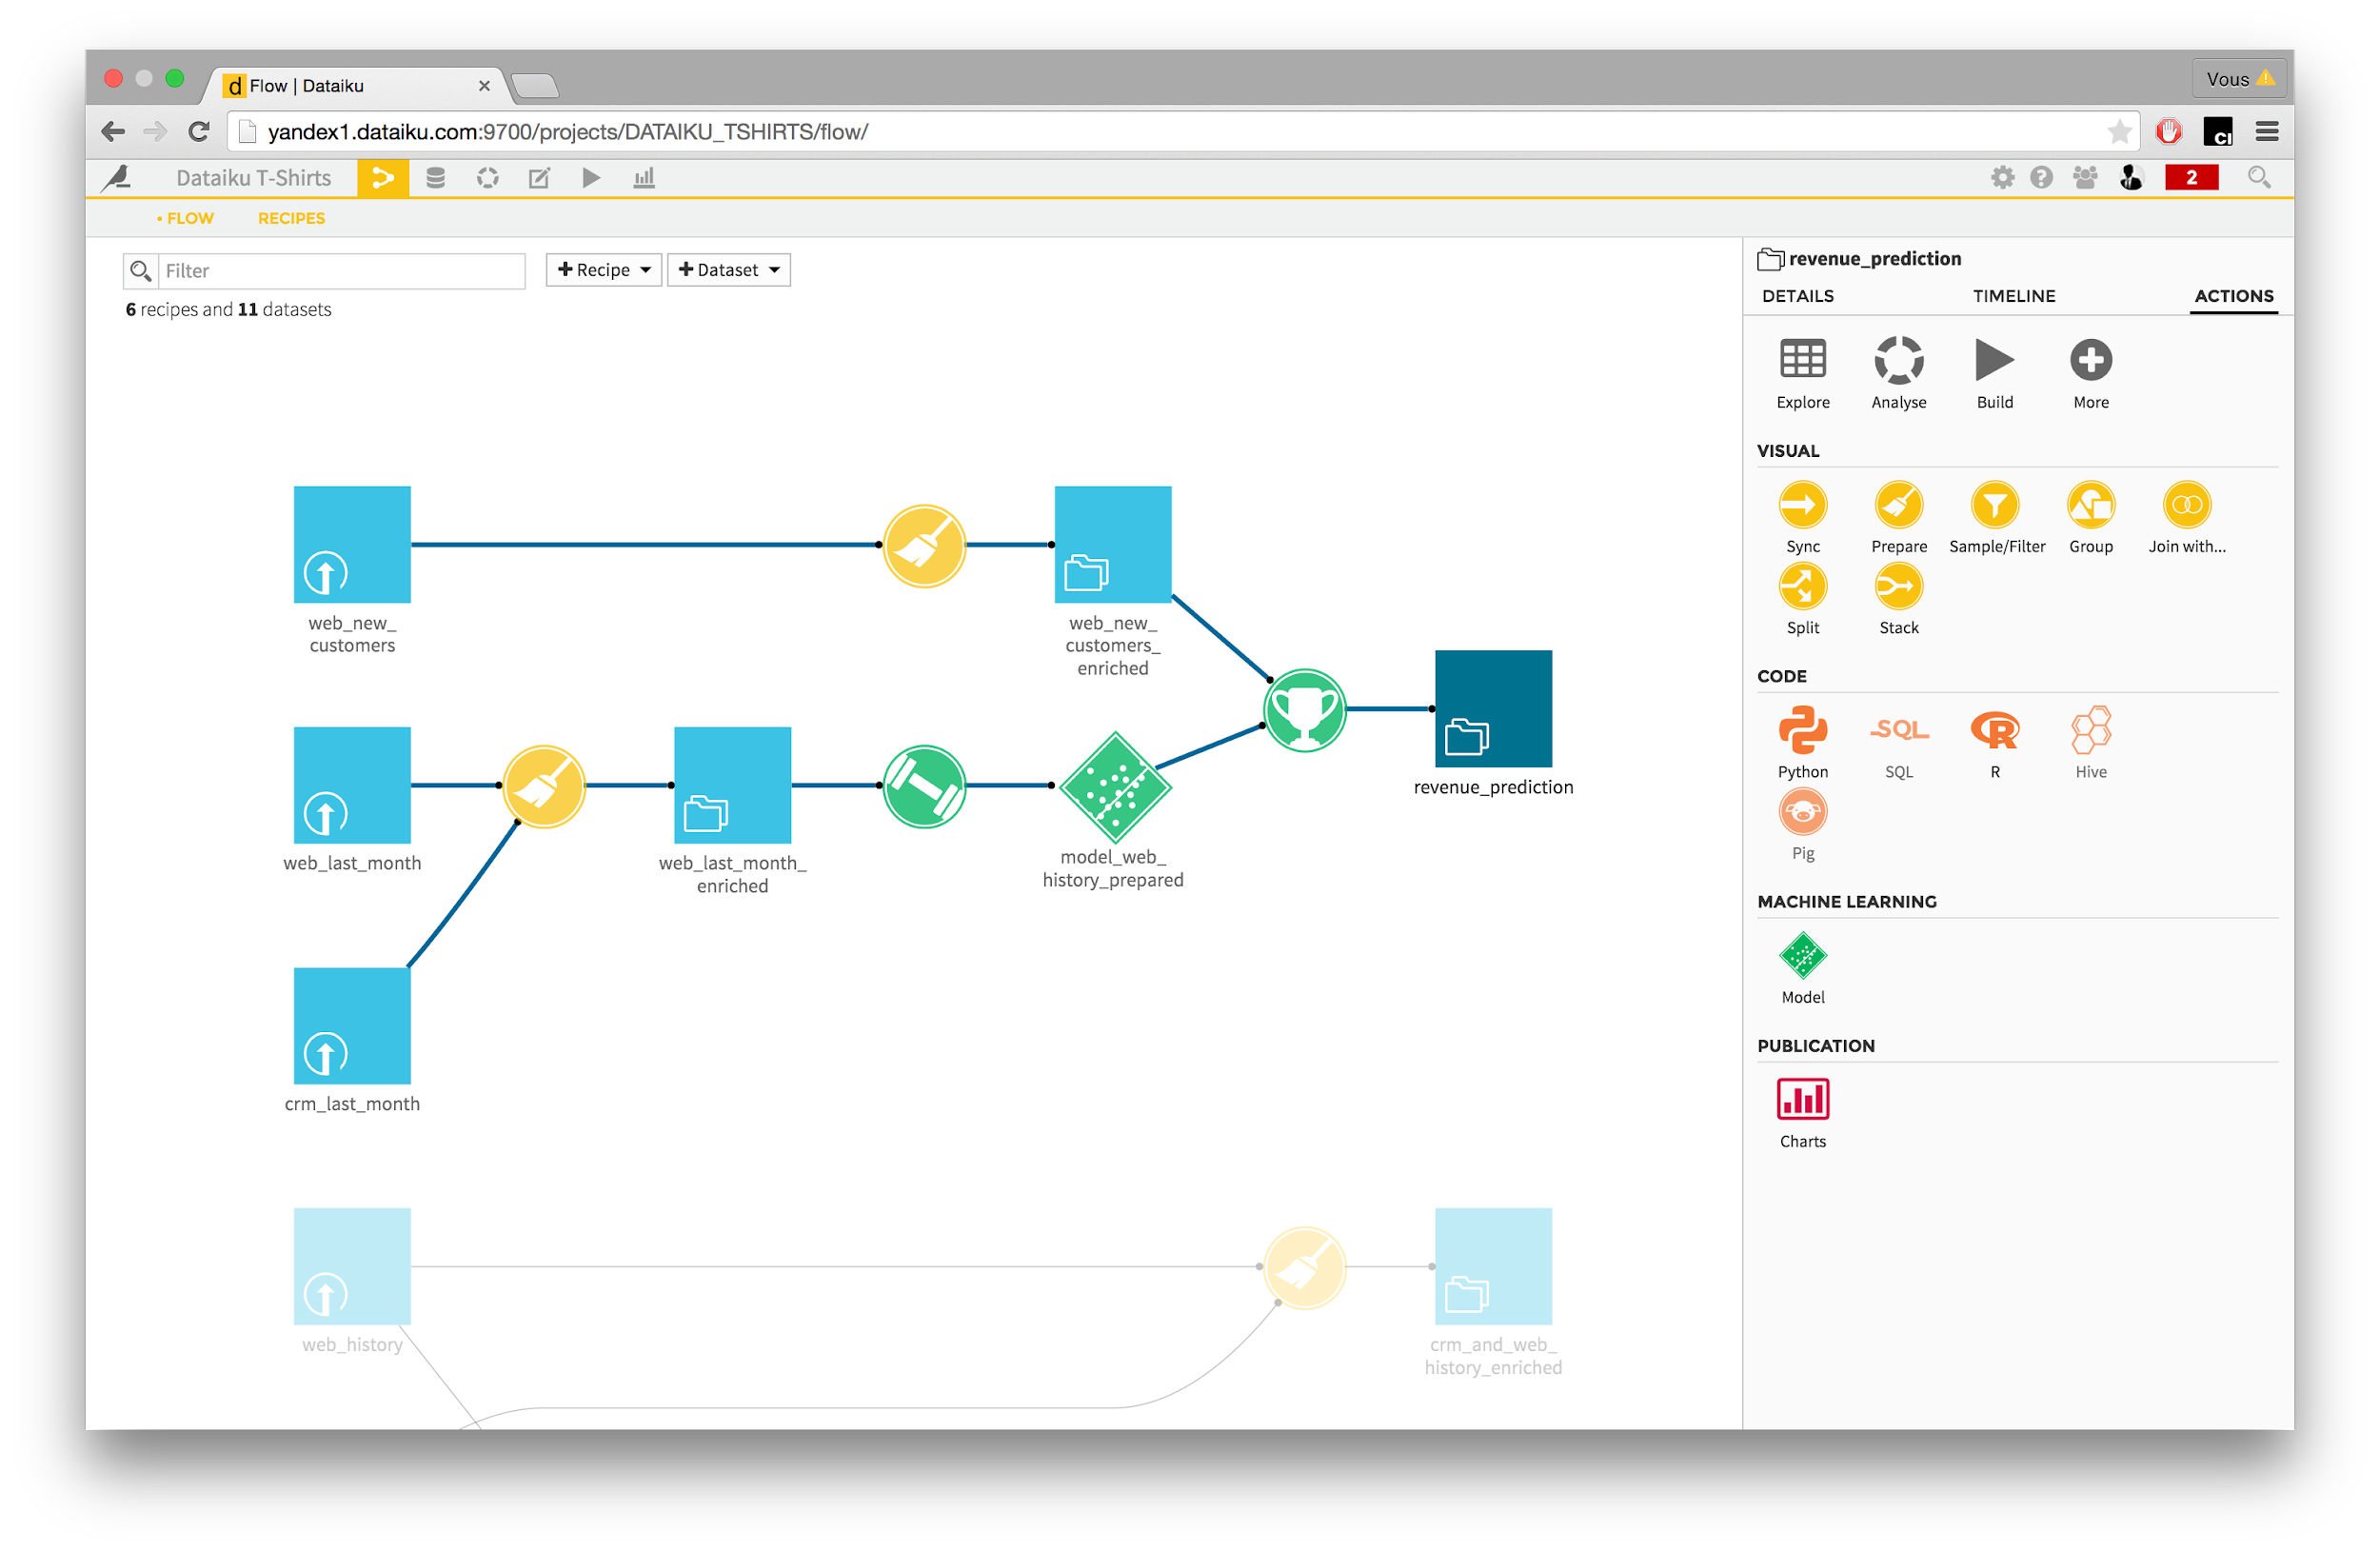
Dataiku DSS
A Brief History of Dataiku
2013
2014
2015
2016
2017
2018
2019
2020
2021
2022
Dataiku
Created
20th employee
100th employee
500th employee
1000th employee
Company
Office in NY
Office in London
Offices in Singapore & Australia
$4M raised
$14M Series A
$28M Series B
$101M Series C
$100M Series D
$400M Series E
$4.6B Valuation
First customer
First 10+
users customers
50th
customer
100th
customer
1st CAB
Customer Advisory Board
300th
customer
Customers
First 100+
users customers
First 500+
users customers
First 1000+
users customers
1000+
EGG Visitors
7
Software
Version 1
1st tool integrating
data prep and ML
Version 3
Scenarios, automation and version control
Version 4
Advanced scalability,
cloud support
Version 5 Deep learning,
Containerization, Project wikis
Version 6
Enterprise Scale Elastic AI with Kubernetes
Version 7
Explainable AI and
Advanced Visual Statistics
Version 8
Applications-as-Recipes, Flow Zones, Model Doc Gen
Version 9
ML Diagnostics, Model Assertions, What-If Analysis, Fuzzy Join
Version 10
Model Evaluation & Comparison, What-if accelerators, Geo join, DeepHub
Version 11
Visual Time Series, Code Studio, Outcome Optimization, Experiment Tracking
Notes:
- Dataiku was founded in 2013 in Paris, gained 1st customer using a beta. Since then it has grown quickly, opening offices in NYC, London, Singapore, Australia among others, and 3 rounds of funding, our 300th customer & 400th employee (plus size of clients installs growing)
- CapitalG, the investment arm of Alphabet Inc. (holding company for Google), invested in Dataiku at a 1.4B USD valuation!! This shows clear trust and validation from investors and customers.

Slide 4
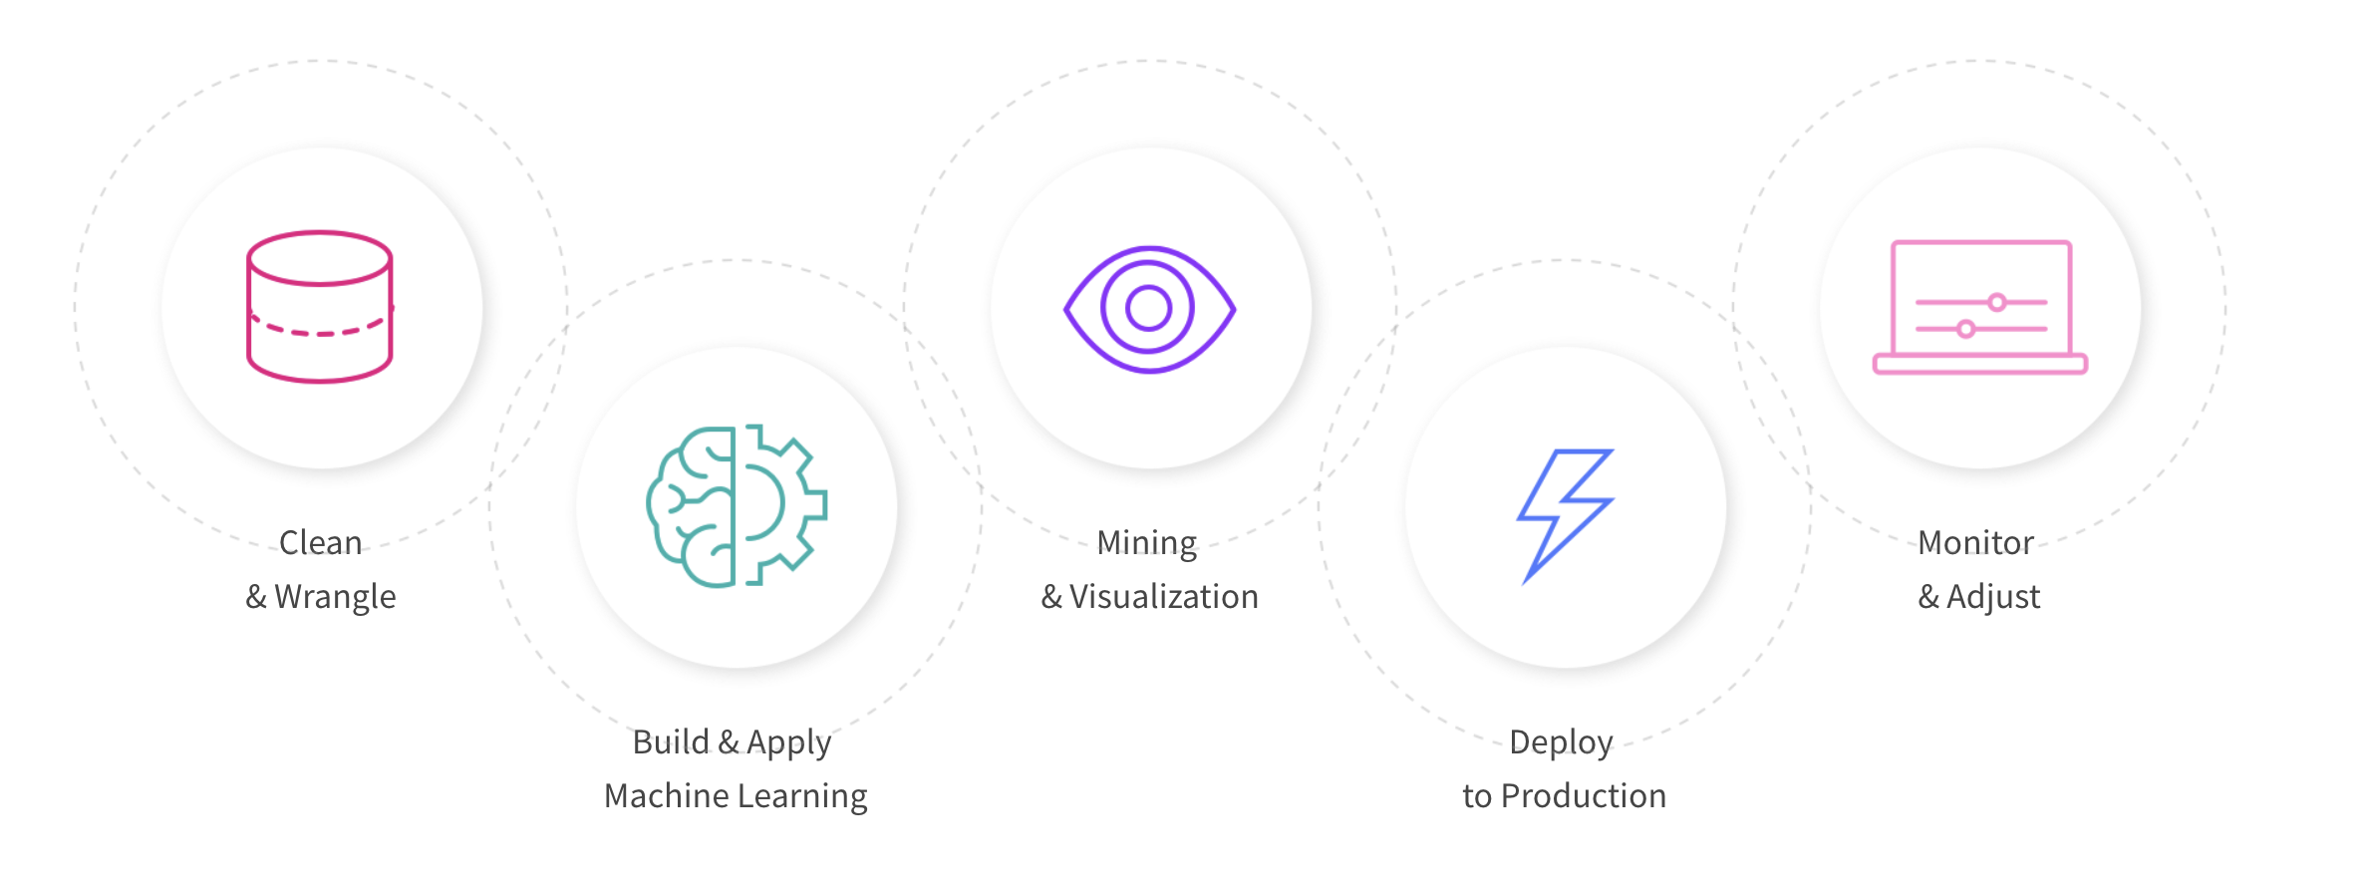
End-to-end Software

Slide 5
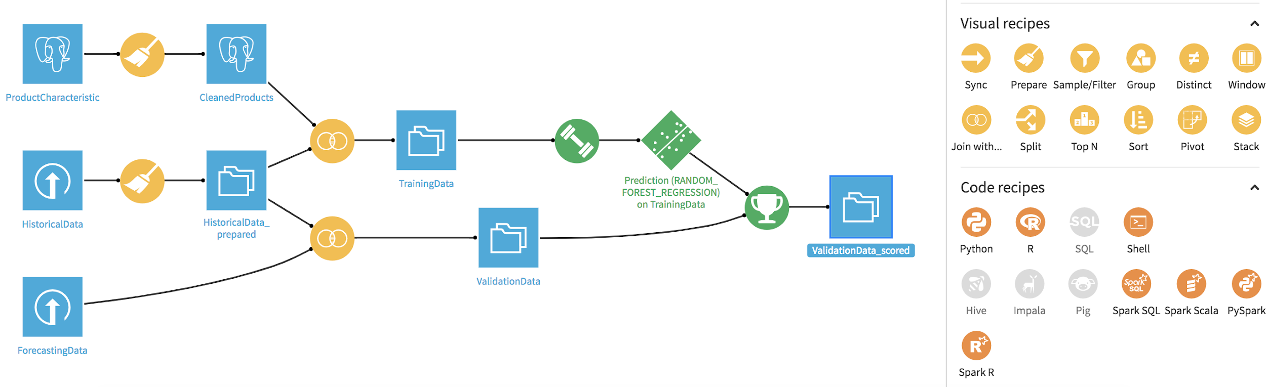
Skill agnostic platform that supports all data project stakeholders
End-to-End Platform Solution
DATA CATALOGING AND CONNECTIVITY
DATA PREPARATION
(AUTO) MACHINE LEARNING
PRODUCTION DEPLOYMENT
VISUAL
CODE
GOVERNANCE, VERSIONING, AUDIT AND REUSE

Slide 6




Dataiku DSS
The “tower of Babel” effect of Data Projects
Visual data preparation
Auto ML
Business Analyst
R, Python, Notebooks, and (many) data science libraries
Model monitoring
Data Scientist
Visualization and validation
Visualization and validation
Analytics Leader
Refactored data project
IT monitoring
Data Engineer

Slide 7

Dataiku DSS
Bring Business Analysts, Engineers, and Scientists Together
Visual Data Preparation
Auto ML
Business Analyst
R, Python, Notebooks, and (many) Data Science Libraries
Model Monitoring
Data Scientist
Visualization and validation
Visualization and validation
Analytics Leader
Refactored data project
IT Monitoring
Data Engineer

Slide 8
Dataiku DSS
End-to-end Software
Notes:
Dataiku DSS is an end to end platform where you will be able to:
Clean data
Build and apply ML
Visualise data and produce reporting insights
Deploy your models to production
And Monitor

Slide 9
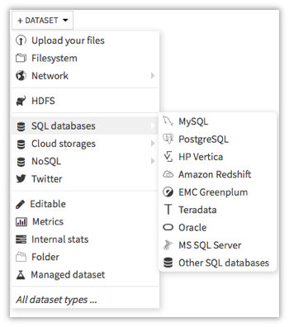
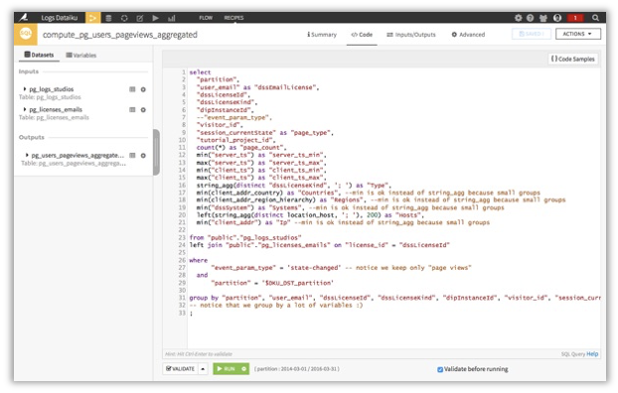
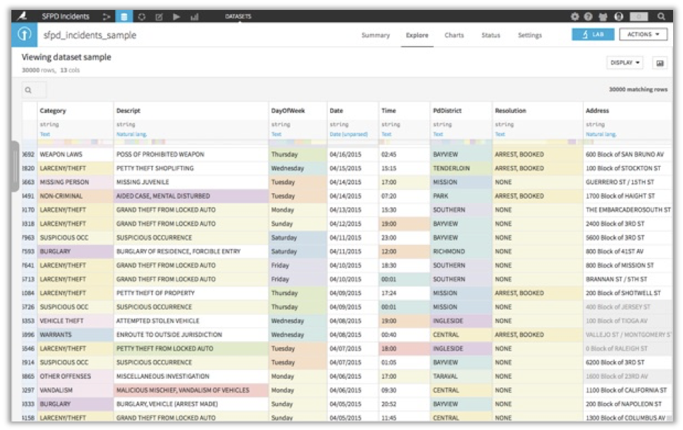
Dataiku DSS
Data Access and Processing
DEVELOP REUSABLE/MAINTAINABLE DATA FLOWS
CONNECT TO YOUR (MANY) DATA SOURCES
Simple representation of overall data processing despite complexity of underlying operations
Portability of in-built recipes to various execution engines
Click based connection to your datalake, databases, flat files or any other source
Native connectors for most common technologies (SQL, Hadoop, Spark, NoSQL…)
Find relevant data with the catalog
CODE… OR CLICK
Code in your language of choice (R, Python, SQL…)
Use the 100 in-built processors to perform advanced operations in a few click
Package your specific processes in reusable click based plugins for wide usage
UNDERSTAND YOUR DATA
Directly navigate through data samples and compute the key
Build immediate visualisation for self- or shared- use
LEVERAGE VARIOUS COMPUTE RESOURCES
Push process execution in your databases or computation clusters
Deploy via containers or spin up compute resources
Notes:
data sources
Click based connection to your datalake, databases, flat files or any other source
Native connectors for most common technologies (SQL, Hadoop, Spark, NoSQL…)
Find relevant data with the catalog
understand your data
Directly navigate through data samples and compute the key
Build immediate visualisation for self- or shared- use
develop maintainable flows
Simple representation of overall data processing despite complexity of underlying operations
Portability of in-built recipes to various execution engines
code or click
Code in your language of choice (R, Python, SQL…)
Use the 100 in-built processors to perform advanced operations in a few click
Package your specific processes in reusable click based plugins for wide usage
leverage various compute resources
Push process execution in your databases or computation clusters
Deploy via containers or spin up compute resources

Slide 10
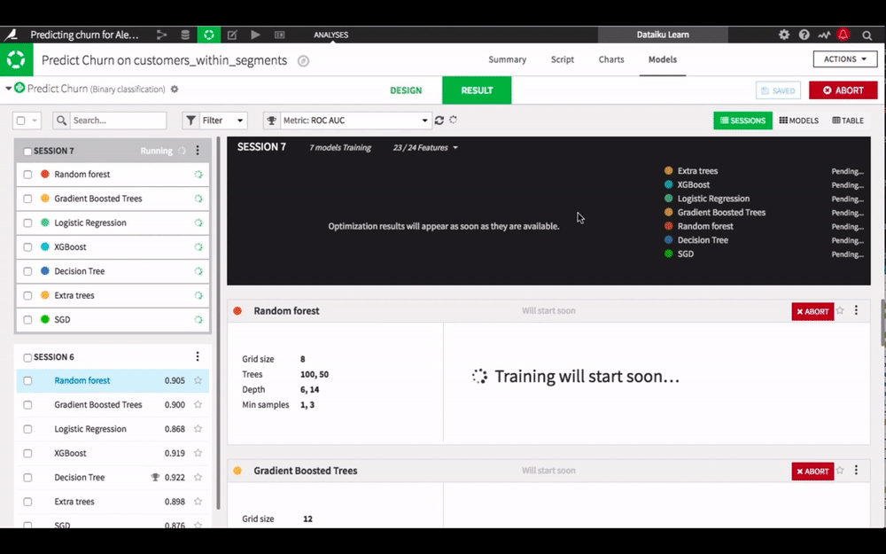
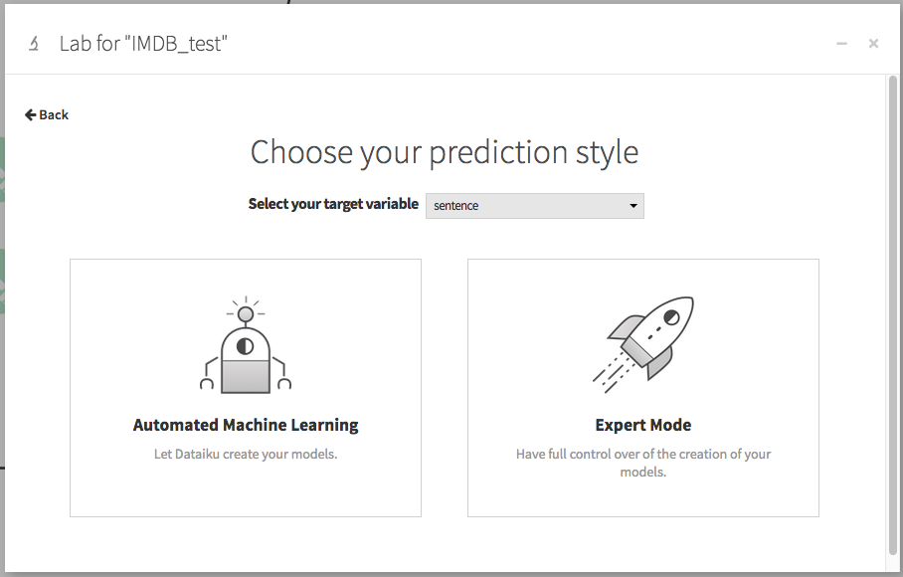
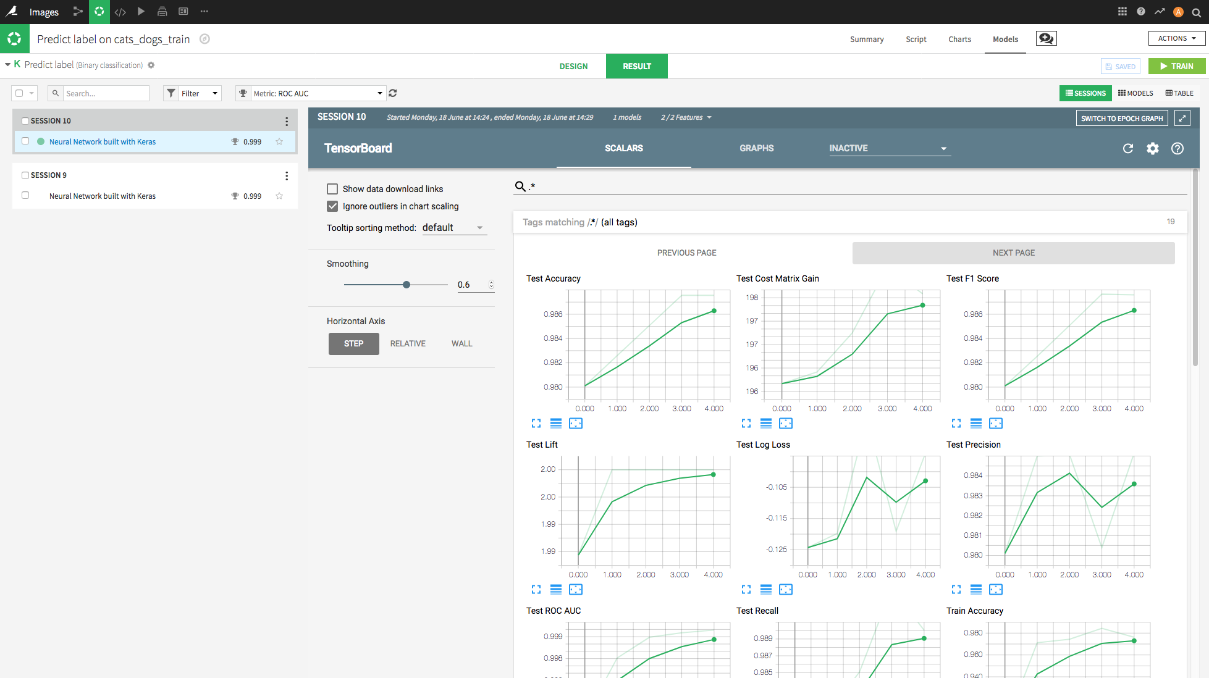
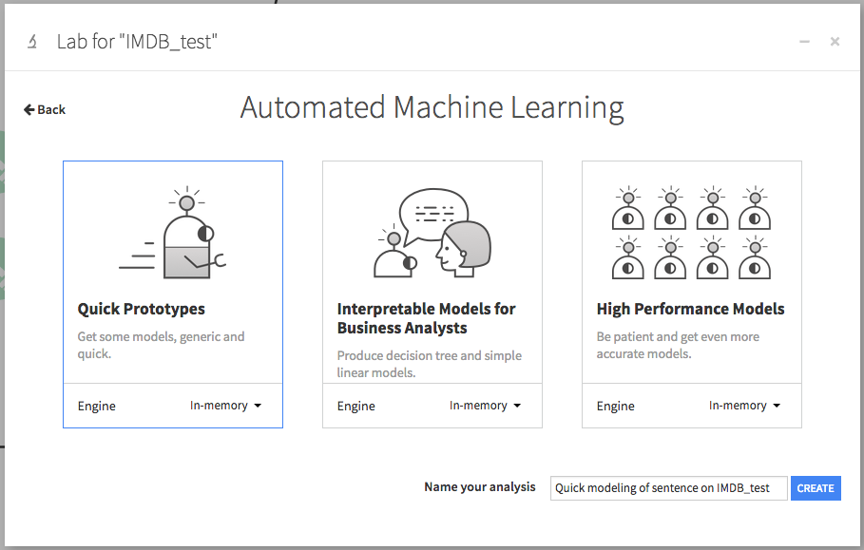
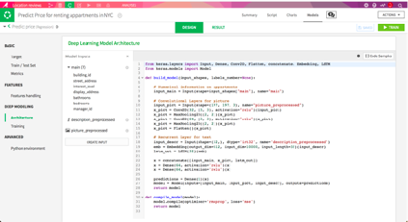
Dataiku DSS
Machine Learning
AUTO-ML OR CODE BASED
FULL TRAINING MANAGEMENT
Notes:
auto ML or code based
Create, improve, and automatically compare multiple machine learning models in a few clicks
Leverage the best ML libraries in the way most suited to your users
full training management
Track model performance
Historize trainings, setup and sessions
Select best performers or revert to past designs
Update your model with ease: add new data, create new variables in your models, and check the variation (%) in the core metrics

Slide 11






Dataiku DSS
Solution Overview: Architecture
Browser based interface
Notes:
Users access dataiku via a browser

Slide 12










Dataiku DSS
Solution Overview: Architecture
PRODUCTION SYSTEMS
Dataiku deployment servers for enterprise grade operationalization
CENTRALIZED OR AD-HOC DATA SOURCES, DATABASES, DATA LAKE
Leveraging best storage and compute resources
LINUX SERVER
ON PREMISE OR MANAGED CLOUD
AVAILABLE OR SPUN-UP PROCESSING RESOURCES
Centralized server to facilitate
access to data, ressources, and foster collaboration
Notes:
DSS is installed on a Linux server on Premises

Slide 13
Dataiku DSS
Solution Overview: Architecture
PRODUCTION SYSTEMS
Dataiku deployment servers for enterprise grade operationalization
CENTRALIZED OR AD-HOC DATA SOURCES, DATABASES, DATA LAKE
Leveraging best storage and compute resources
LINUX SERVER
ON PREMISE OR MANAGED CLOUD
Browser based interface
AVAILABLE OR SPUN-UP PROCESSING RESOURCES
Centralized server to facilitate
access to data, ressources, and foster collaboration
Notes:
Users connect to that server and are provided with access to the data sources that the server is connected to

Slide 14
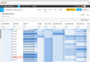
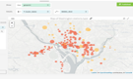
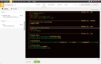
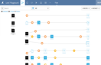
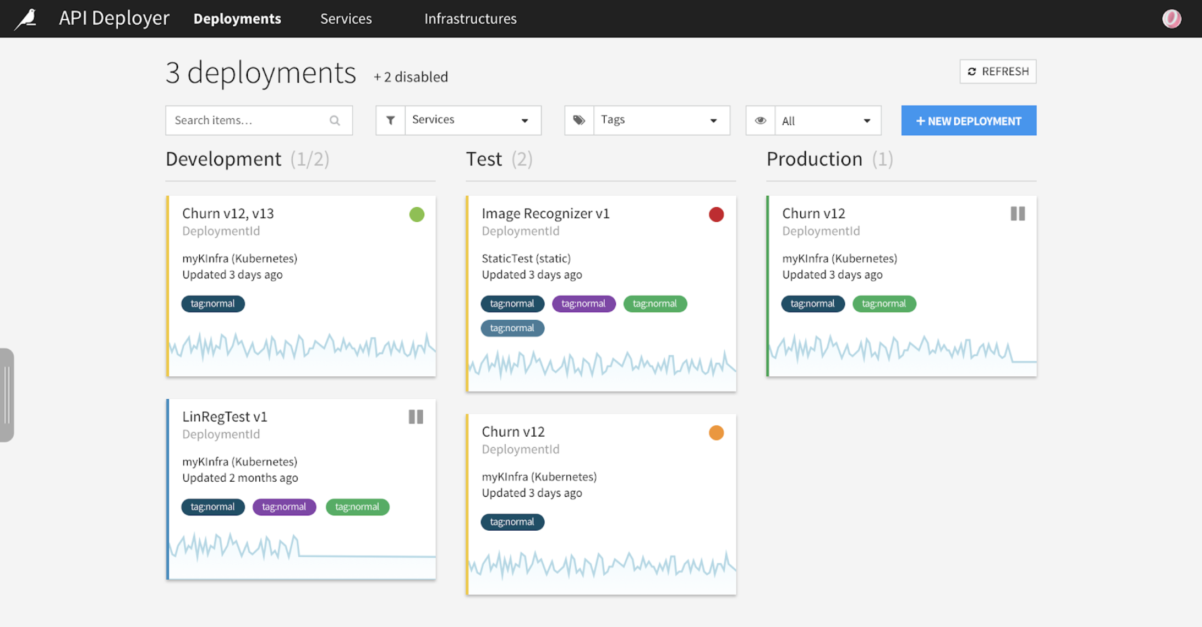
Dataiku DSS
Solution Overview: Architecture
PRODUCTION SYSTEMS
Dataiku deployment servers for enterprise grade operationalization
User/task specific
interaction modes
CENTRALIZED OR AD-HOC DATA SOURCES, DATABASES, DATA LAKE
VISUAL DEVELOPMENT
VISUALIZATION
Leveraging best storage and compute resources
COMPLETE CODING ENVIRONMENTS
COLLABORATION AND PROJECT MANAGEMENT
LINUX SERVER
ON PREMISE OR MANAGED CLOUD
Browser based interface
AVAILABLE OR SPUN-UP PROCESSING RESOURCES
AUDIT, MONITORING AND SCHEDULING
Centralized server to facilitate
access to data, ressources, and foster collaboration
Notes:
and this allows the users to perform all the tasks through the interaction with that server

Slide 15
Dataiku DSS
The “tower of Babel” effect of Data Projects
Visual data preparation
Auto ML
Business Analyst
R, Python, Notebooks, and (many) data science libraries
Model monitoring
Data Scientist
Visualization and validation
Visualization and validation
Analytics Leader
Refactored data project
IT monitoring
Data Engineer

Slide 16
Dataiku DSS
Bring Business Analysts, Engineers, and Scientists Together
Visual Data Preparation
Auto ML
Business Analyst
R, Python, Notebooks, and (many) Data Science Libraries
Model Monitoring
Data Scientist
Visualization and validation
Visualization and validation
Analytics Leader
Refactored data project
IT Monitoring
Data Engineer

Slide 17







Traditional programming
Machine Learning
Automatically finds patterns
if color == red:
if shape == round:
fruit = tomato
if color == yellow:
fruit = banana
pattern
(model)
Notes:
Machine learning is a specific part of Data Science. It handles the statistical aspect of Data Science

Slide 18

identifying a pattern
Input Data
1. Machine learning applied to business
CONCEPT : Provides to systems the ability to automatically learn and improve from experience without being explicitly programmed, relying on patterns “instead”
Notes:
Machine learning is a specific part of Data Science. It handles the statistical aspect of Data Science

Slide 19

2. Types of Machine Learning
FEATURES
LABEL
Supervised
Strawberry
Not Strawberry
Not Strawberry
Strawberry
Strawberry
LABELLED DATASET
Strawberry
FEATURES
Unsupervised
Cluster1
Cluster3
UNLABELLED DATASET
Cluster2

Slide 20
2. Types of Machine Learning
Supervised
Algorithm:
The model tries to find patterns based on historical data in order to predict the specified target
“What differentiates a strawberry from a non-strawberry ?”

Slide 21
2. Types of Machine Learning
Unsupervised
Algorithm:
The model finds patterns, segmentation on unlabelled data through clustering in distinct group
The model finds patterns, segmentation on unlabelled data through clustering in distinct group

Slide 22
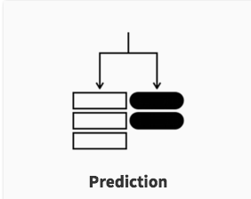
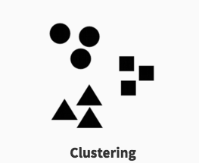

2. Types of Machine Learning
Supervised
Unsupervised
Predicting mortgage defaults
Forecasting lifetime spending of customer
Grouping songs into genres
Predicting amount of snowfall
Segmenting website visitors
Recommending movies to Netflix users
Detecting unusual financial transactions
(classification)
(regression)
(regression)
(regression)
(classification)

Slide 23
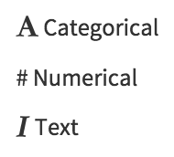
2. Types of Machine Learning
If... Supervised
If target is
then regression
Ex: predicting price of airline tickets
If target is
then classification
Ex: predicting fraud

Slide 24
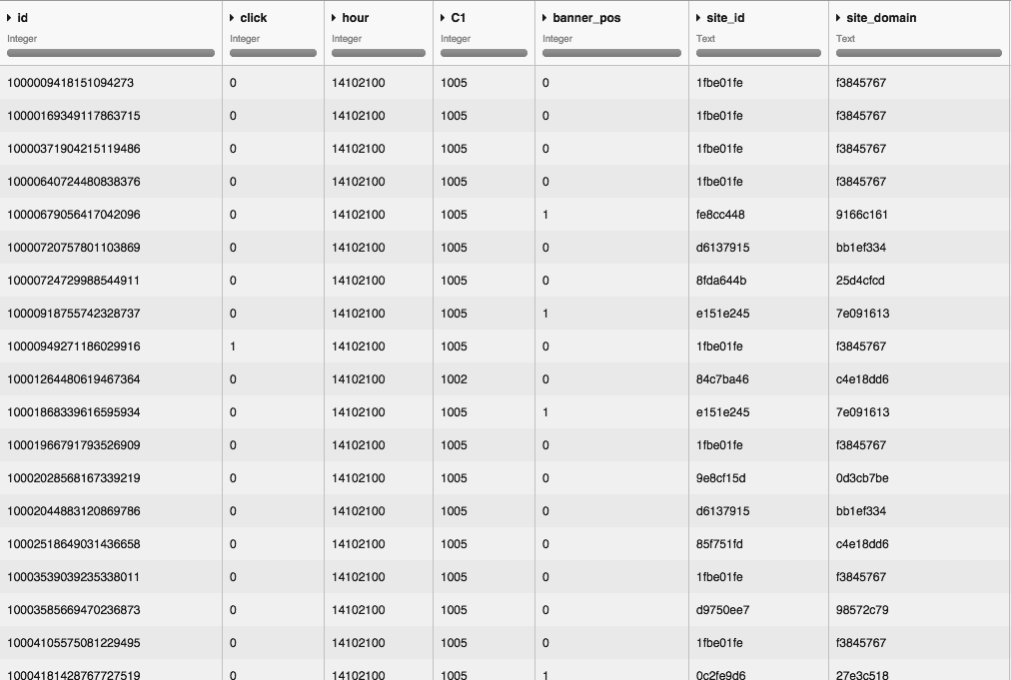
3. Making a prediction; Interpreting the results
A dataset that can be understood by a learning machine algorithm:
Columns : features (i.e. what we have measured)
Rows : observations (i.e. On what we have measured)
Possibly, a target column (what we want to predict)
Target
feature_1
feature_2
feature_n
Observations

Slide 25
3. Making a prediction; Interpreting the results
Phase 1: Learning from your data / Training your algorithm
Phase 2: Provides prediction for new data
Hyperparameters
Dataset
Optimization algorithm
Parameters
Target
Trained
Algorithm
New Dataset
Predicted Target

Slide 26

3. Making a prediction; Interpreting the results
Training set
Used to create your model
Validation set
Used to regularly check model performance after deployment
Testing set
Used to measure performance
Data NOT present when creating the model
⇒ if your performance declines, maybe it’s time to retrain your model with fresh data
Data present when creating the model

Slide 27

4. The Concept of overfitting
 | Under-fitted | Good model | Over-fitted
Error on Training set | Large | Small | Small
Error on Testing set | Large | Small | Large

Slide 28
Hands-on 1 (Classification)
Predicting fraudulent card transactions
Notes:
TIMING 10:25

Slide 29

Elo
Background
Major Brazilian debit and credit card brand
Over 80 million issued cards

Slide 30
Elo
Data
Credit Card Transactions
January 2017 - April 2018
Cardholder Data
Merchant Data

Slide 31
Elo
First Steps
Understand trends of fraudulent (and legitimate) transactions
Statistical analysis
Visualizations

Slide 32
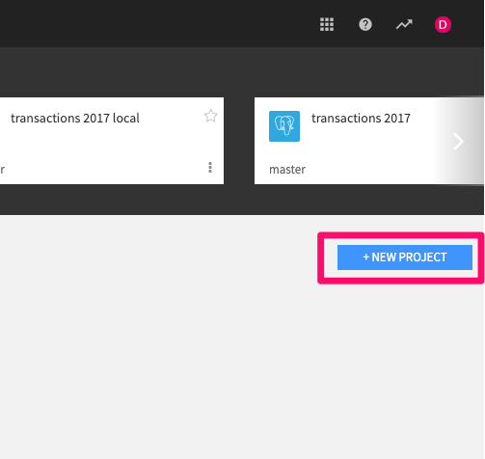
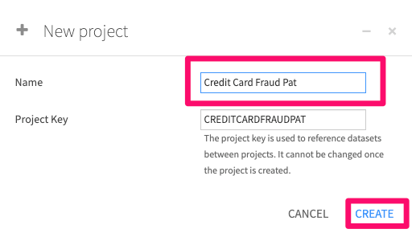
Create a new project
Name your project “Credit Card Fraud” + your name

Slide 33
Data Sources Overview: Import 3 Datasets
Download here : https://dl.dataiku.com/#/?id=zS9LdHdiW93VslNE
transactions
consumer credit card transactions
cardholder_info
credit score for each cardholder
merchant_info
Lookup table for merchants

Slide 34
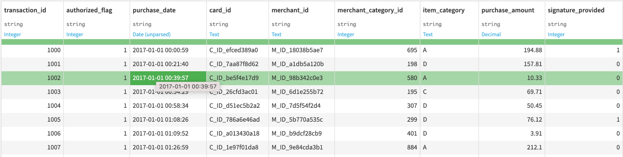
Explore the transaction_2017 data
Each row is a transaction. The authorized_flag shows whether it was approved or not.

Slide 35
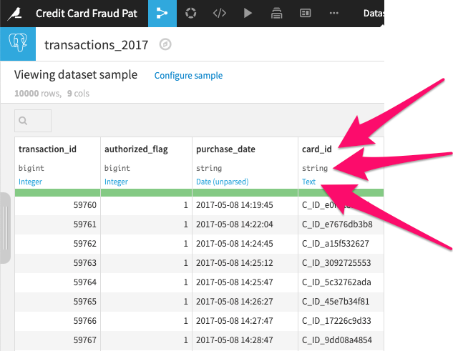
Column attributes
Column name
Schema - the storage type
ex. string, int, double, array
Meaning - the “human readable” meaning
ex. text, integer, IP address, gender
We can see information about each column and its contents
Notes:
The green bar is the percentage of rows (in the current sample) which conform to the column’s meaning.

Slide 36
Questions
What is the highest individual purchase amount?
What percentage of transactions are unauthorized (fraudulent)?

Slide 37

Stack
Merge two or more datasets into one
Equivalent to a “union all” SQL statement
Good for datasets with substantially the same columns/schema
Notes:
Link to Academy- visual recipes: Video to the introduction: https://academy.dataiku.com/visual-recipes-overview-1/500658
Link to academy: https://academy.dataiku.com/visual-recipes-overview-1/500688

Slide 38
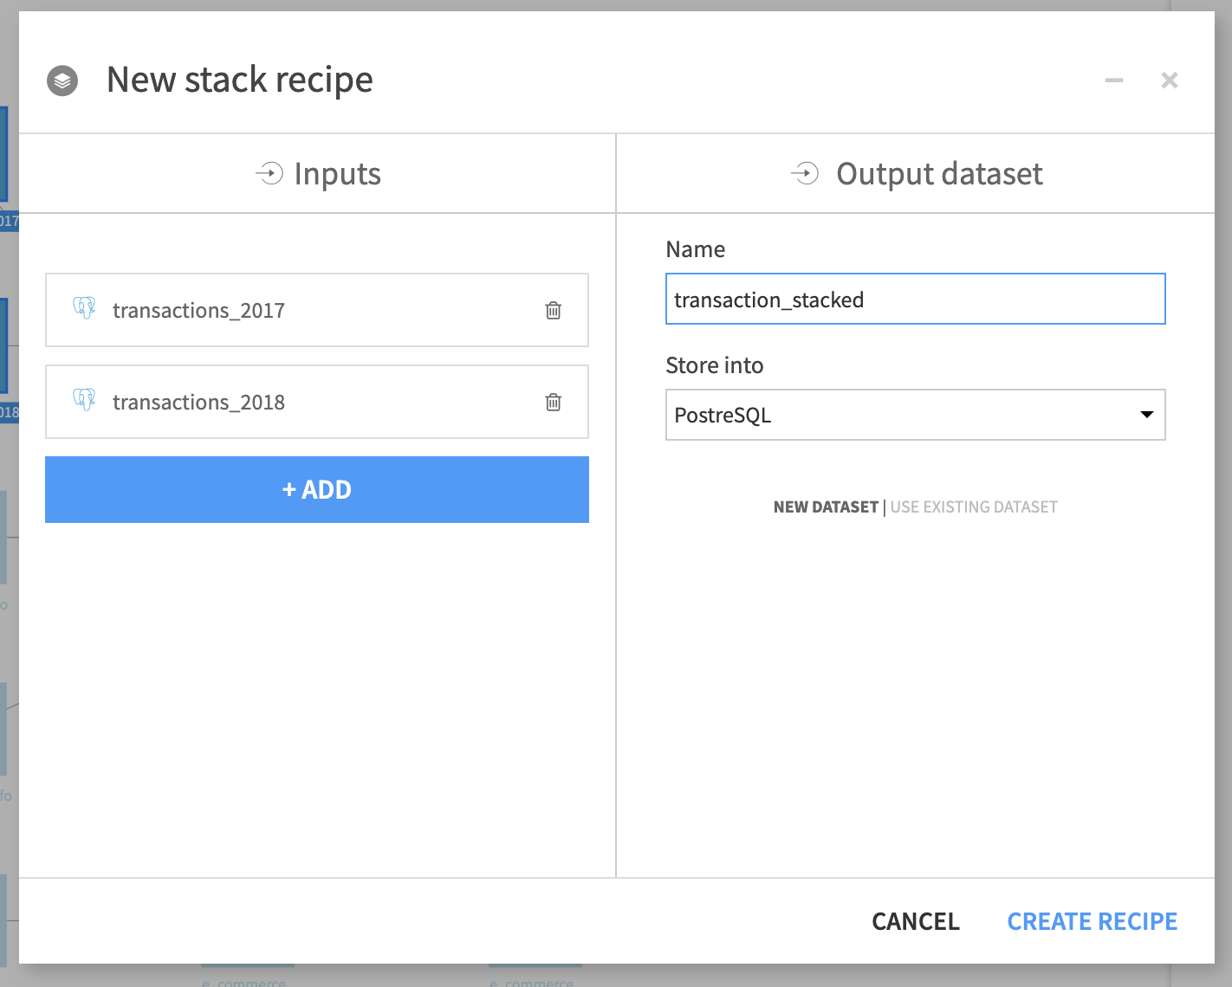
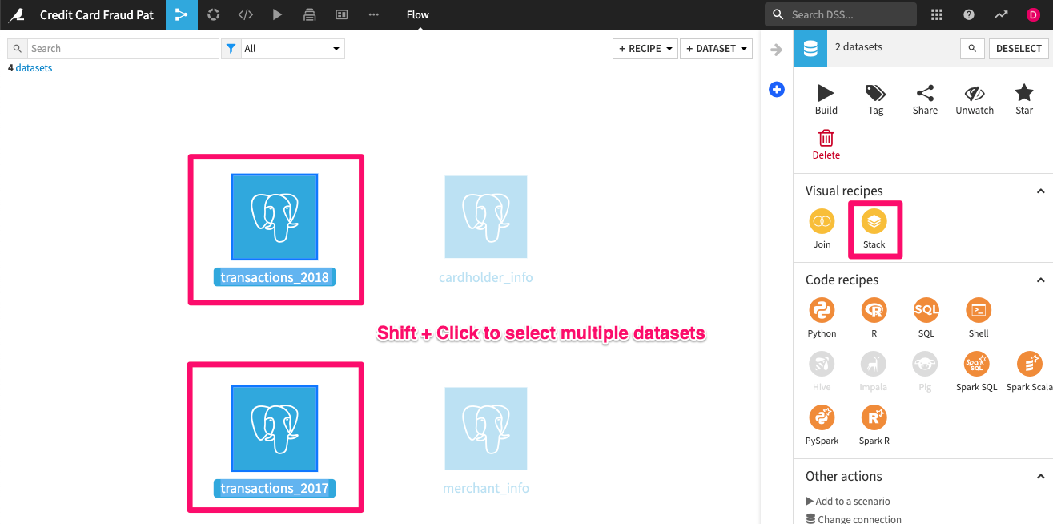
Stacking Datasets
Stack the transactions datasets together

Slide 39

Join
Join two or more datasets
Perform inner joins, left outer joins, full outer joins, right joins, etc.
Define join conditions using the UI or SQL

Slide 40
Join the transactions dataset with the other two datasets
LEFT JOIN transactions dataset with cardholder_info dataset ON ‘card_id’ = ‘internal_card_mapping’
LEFT JOIN transactions dataset with merchant_info dataset ON ‘merchant_id’ and ‘merchant_category_id’
ADD PREFIXES “card” and “merchant” to columns from the two datasets respectively
Do this all in ONE Join recipe

Slide 41
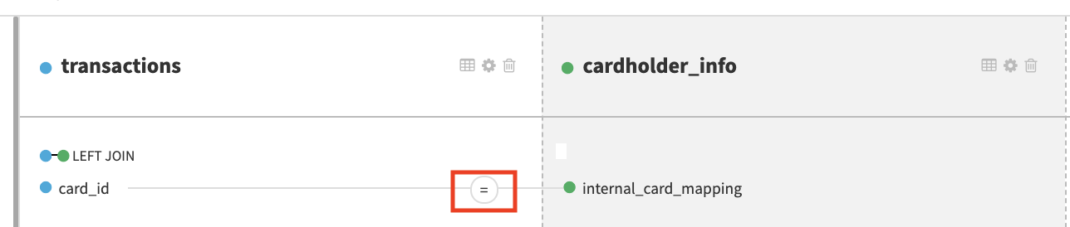
LEFT JOIN transactions with cardholder_info
Sometimes DSS guesses the wrong desired join columns
Click the equals sign to change the join

Slide 42
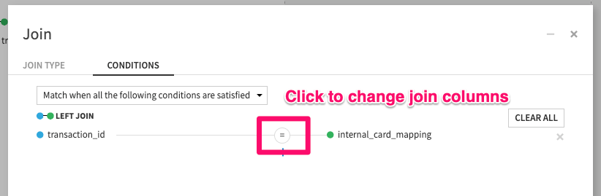
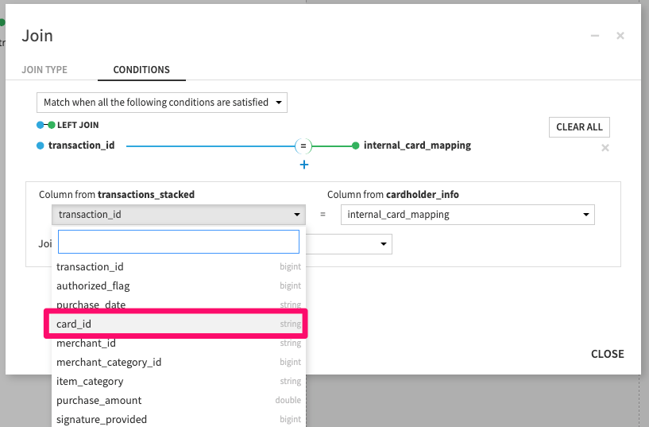
LEFT JOIN transactions_stacked with cardholder_info
Change the columns to join on
‘card_id’ = ‘internal_card_mapping’

Slide 43
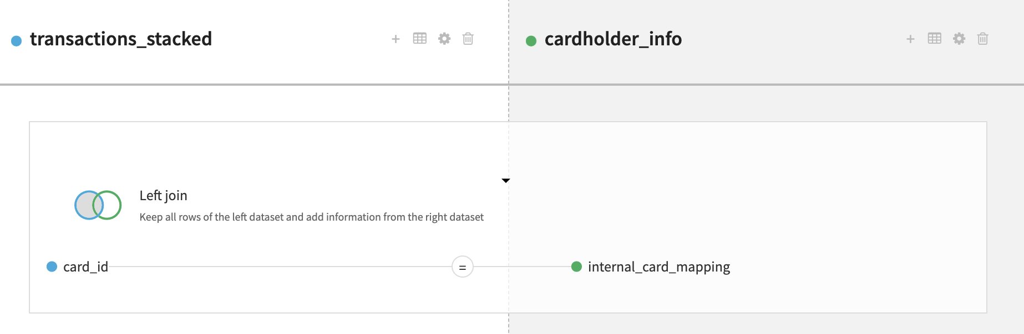
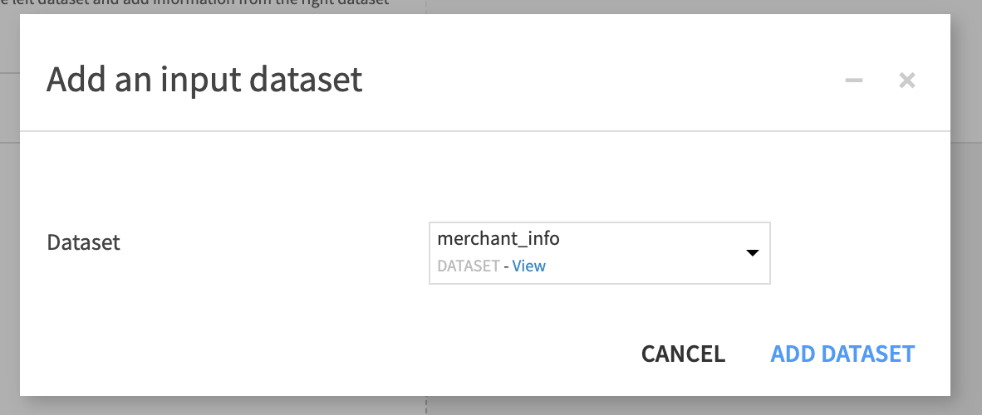
LEFT JOIN transactions_stacked with merchant_info
Add a new dataset input
Select the merchant_info dataset from the dropdown

Slide 44
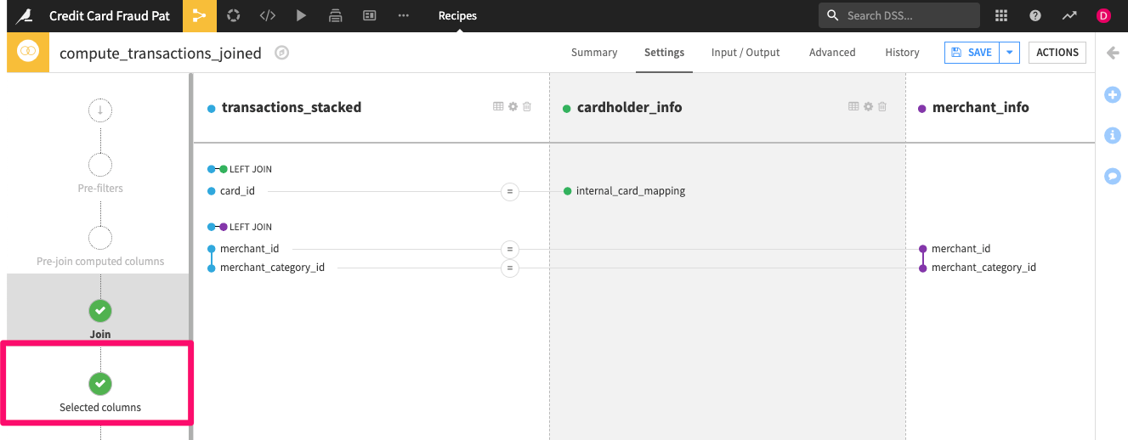
LEFT JOIN transactions_stacked with merchant_info
This looks good!
Now let’s look at the Selected Columns tab

Slide 45
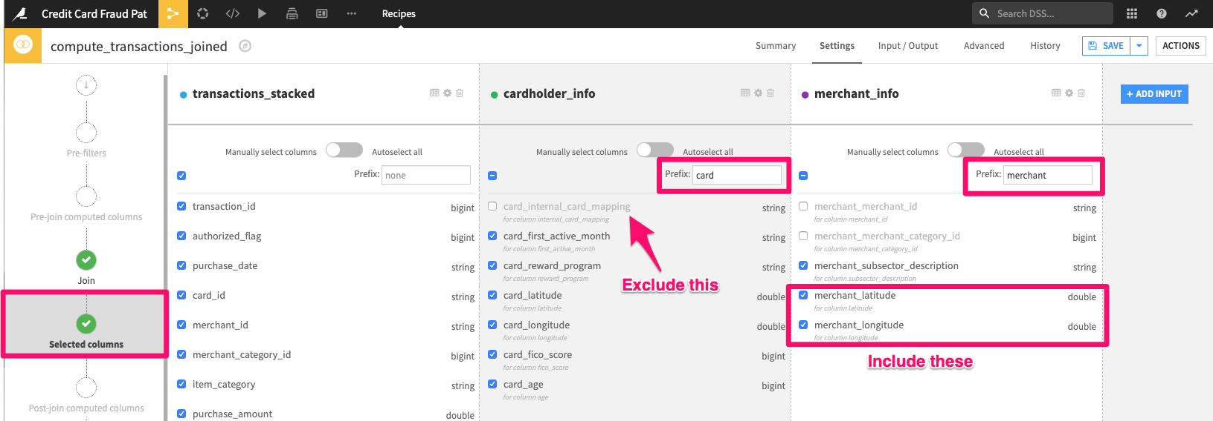
Add prefixes to columns from joined datasets
Deselect ‘card_internal_card_mapping’
Select ‘merchant_latitude’ and ‘merchant_longitude’
Any ideas why merchant latitude/longitude cols weren’t included initially?

Slide 46

Prepare
~90 different processors, including
Find and replace
Date manipulations
Mathematical operations on columns
Splitting columns
Extracting parts of columns
Text parsing and NLP
Geographic transformations

Slide 47
Create time-based features
Parse dates: card_first_active_month and purchase_date
Extract date components from purchase_date_parsed
year, month, day, dow, hour
Create a purchase_weekend (sat/sun) column using a DSS formula
Create a days_active column: the time from the cardholder’s first_active_month until purchase_date

Slide 48
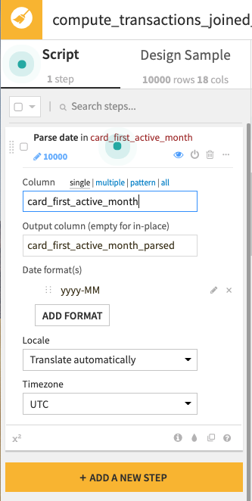
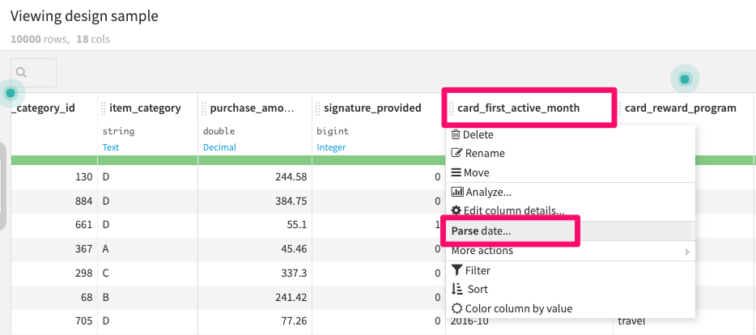
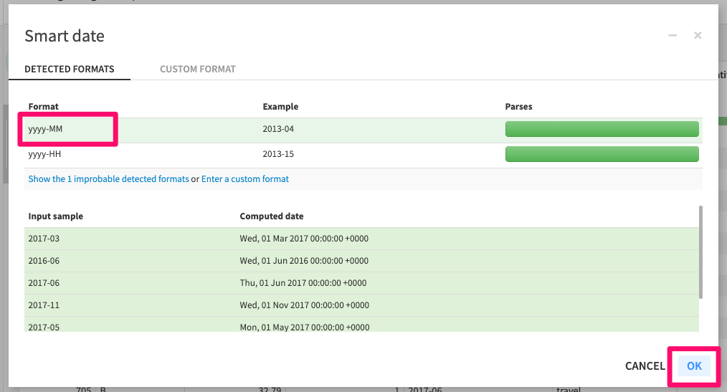
Parse card_first_active_month
We want yyyy-MM format
1
3
2

Slide 49
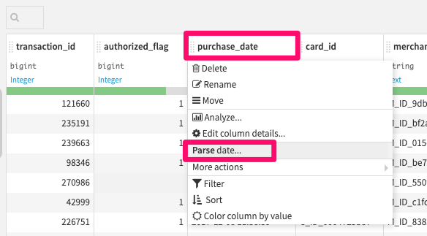
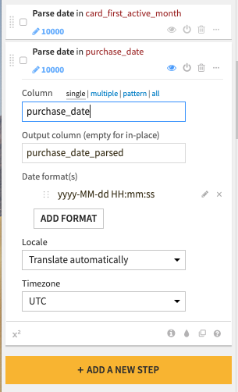
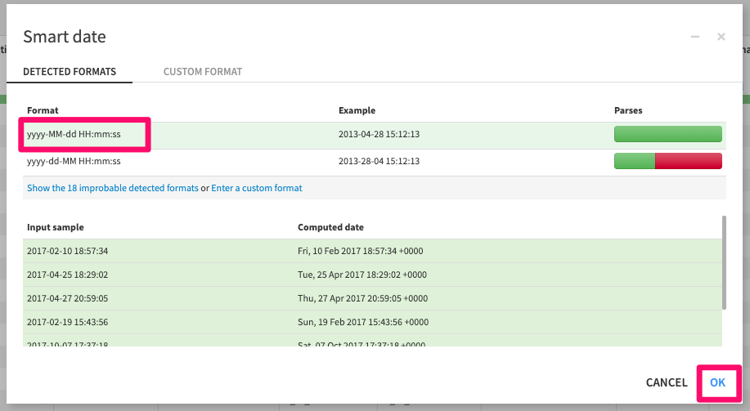
Parse purchase_date
1
3
2
Note: if you wanted to parse in-place, you could delete the output column name to do that

Slide 50
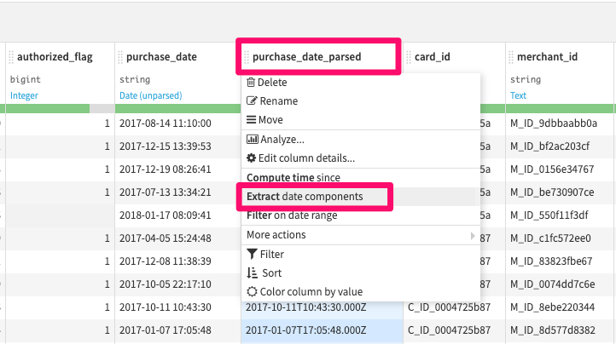
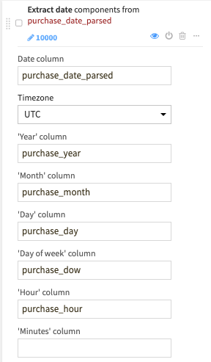
Extract date components from purchase_date_parsed
Clean up column names:
for example… purchase_date_parsed_year → purchase_year
Add:
purchase_dow
purchase_hour
2
1

Slide 51


Create binary purchase_weekend column
Use a DSS Formula!
We are defining weekends as Friday/Saturday
Let’s add this one using the
+ ADD A NEW STEP button

Slide 52


Create binary purchase_weekend column
Click “EDIT” to pull up examples and reference
Make sure to “SAVE” your formula back to the processor
You can add comments to document potentially complex formulas!

Slide 53


Compute the time from first active month to purchase date
Let’s add this one using the + ADD A NEW STEP button
Name the output column:
days_active

Slide 54


You can Group your date cleaning steps
Call your group “Date Formatting”
This is much easier to read!
You can also modify colors or add descriptions !

Slide 55
Create geolocation features
Create geopoint columns
merchant_location using the merchant latitude & longitude
cardholder_location using the cardholder latitude & longitude
Reverse geocode
merchant_location to get the merchant_state
cardholder_location to get the cardholder_state

Slide 56


Create merchant geopoint column
Use the processor search

Slide 57

Create cardholder geopoint column
Do the same thing for the cardholder locations!

Slide 58


Reverse geocode the merchant location
Use the processor search
We can choose what to extract.
In “region”, enter “merchant_state”

Slide 59


Reverse geocode the cardholder location
Feeling lazy? Duplicate and modify!

Slide 60


Compute the distance between cardholders and merchants
Use the processor search

Slide 61



Machine Learning
Predict fraudulent transactions using machine learning

Slide 62



Challenge 1 Steps
Split the data into records where we know the fraud/no fraud status
Train a machine learning model in DSS using known 2017 data
Use the model to make predictions for unknown 2018 data

Slide 63

Split

Slide 64
Split
Split a dataset
Randomly
Based on some condition

Slide 65
Split the joined dataset into known and unknown datasets
Create two new datasets, transactions_known and transactions_unknown
Define a filter
where “authorized_flag” is defined → transactions_known
all other rows → transactions_unknown
We can train our model only on the records where we know the value of “authorized_flag”

Slide 66



Create a split recipe and the two output datasets

Slide 67



Split into known and unknown datasets
...and then click “RUN”

Slide 68
Machine Learning
Create machine learning models using the visual interface
Leverage open source packages like scikit-learn, xgboost, MLlib, Keras, Tensorflow, and H2O
Perform batch-scoring on new data using a trained model
Deploy models as REST API endpoints

Slide 69
Train a model to predict “authorized_flag”
Go to the Lab for the transactions_known dataset
Create a new Visual Model
In the Design tab, try different algorithms and hyperparameters
Train your models - find the best one

Slide 70

Click on the transactions_known dataset and to go to the Lab

Slide 71


Build a AutoML prediction model

Slide 72

Click the Design tab to change ML settings

Slide 73

Machine learning concepts
Regression - predict a continuous numeric target variable
Classification - predict a discrete “class” of your target variable
What type of problem is ours?
Classification

Slide 74

Classification - imbalanced data
Notice that our target column ‘authorized_flag’ is imbalanced - this is problematic
Two things we can try:
Rebalance our train/test sets to undersample rows from the more popular class
Weight error metrics according to the inverse frequency of each class

Slide 75


Rebalance train/test sets
Choose 100,000 records balanced from the ‘authorized_flag’ column

Slide 76

Train/test split
Note: it’s common to split your known data into:
80% - data to train the model
20% - hold-out data to test your model performance

Slide 77

Weight error metrics
Look out for blue boxes for tips
You can weight error calculations based on the target column class (or another column)
Class weights is generally a good place to start

Slide 78
Feature selection
Choose the columns in our dataset to consider when modeling credit card fraud
Consider:
Only include columns which you’ll have prior to the moment you need to make a prediction (no data leakage)
Intuition and subject matter expertise are important

Slide 79

You can turn features “On” in the “Features handling” tab
Notice:
Feature rescaling
Missingness imputation
1
2
Notes:
dont add redundant cols, what do we want enabled, disabled?

Slide 80
Turn on the following features
(From the point of sale)
purchase_month
purchase_day
purchase_dow
purchase_weekend
purchase_hour
purchase_amount
Item_category
signature_provided
(From cardholder_info table)
days_active
card_reward_program
card_fico_score
card_age
(From the merchant_info table)
merchant_subsector_description
merchant_state
merchant_cardholder_distance
merchant_category_id
Notes:
dont add redundant cols, what do we want enabled, disabled?

Slide 81
Algorithm selection and hyperparameter tuning
Try out different ML algorithms/hyperparameters - then see which works best
Consider:
Try both linear and non-linear models at first
Try wider ranges of hyperparameters first, then hone in on the better performing values (e.g. start with random forest max depths of 6, 12, 18. If 12 performs best, then try 10, 12, 14….and so on)

Slide 82

Add a Random Forest with these hyperparameters
Add new hyperparameters as blue bubbles
DSS will try all possible combinations and show you the best one
Notes:
Discuss hyperparameters -- what are they? Give some examples. What is grid search?

Slide 83

What is a Random Forest?
Check out the blue info boxes for more on each algorithm
Notes:
Discuss hyperparameters -- what are they? Give some examples. What is grid search?

Slide 84

Add a Logistic Regression model
This is a classic algorithm and easier to interpret than others
Notes:
Discuss hyperparameters -- what are they? Give some examples. What is grid search?

Slide 85
Algorithms available
DSS supports the following algorithms for visual, in memory ML:
Prediction algorithms
Regression
Ordinary Least Squares
Ridge Regression
Lasso Regression
Classification
Logistic regression
Regression & Classification
Random Forests
Gradient Boosted Trees
XGBoost
Decision Tree
Support Vector Machine
Stochastic Gradient Descent
K Nearest Neighbors
Extra Random Trees
Artificial Neural Network
Lasso Path
Custom Models
Clustering algorithms
K-means
Gaussian Mixture
Mini-batch K-means
Agglomerative Clustering
Spectral Clustering
DBSCAN
Interactive Clustering (Two-step clustering)
Isolation Forest (Anomaly Detection)
Custom Models

Slide 86

Train your models
Notes:
TIMING 12:05

Slide 87
Questions
What are the most important variables used in your model?
What is your best ROC AUC?
Analyze your predictions for cardholders in each merchant subsector- does your model make drastically higher or lower predictions for any sector?
Notes:
TIMING 13:05

Slide 88
Analyze model performance
Metrics like Accuracy, ROC AUC, F1 score, and mean squared error are important.
Consider:
Look at feature importances (how is each column considered by the model) - do they make sense?
Look at the confusion matrix - do you care more about false negatives, false positives, true negatives, true positives?

Slide 89


ROC AUC
link

Slide 90

Analyze model performance
Random forest has the highest AUC - let’s check it out in detail

Slide 91

Variable importance
Tip: some data scientists remove features below a certain importance threshold (e.g. 4%) in the next iteration

Slide 92
Variable importance
Takeaway:
Keep only important features (above 4% importance)
In my random forest model, these were:
merchant_cardholder_distance
card_age
purchase_amount
merchant_subsector_description
merchant_longitude
merchant_category_id
card_fico_score
Your model may be different!

Slide 93

Confusion matrix
This matrix shows the counts of true positives, true negatives, false positives, and false negatives from the holdout test set
Tip: consider your problem.
Do you care more about catching all positives?
Do you care about raw accuracy?
Toggle the above threshold to change model sensitivity

Slide 94

Subpopulation analysis
Make sure your model doesn’t perform significantly different for different subpopulations

Slide 95

Hyperparameter tuning
Find the model configuration which had the highest score
For me, it was:
n_estimators = 450
max_depth = 20
min_samples_leaf = 3

Slide 96

Choose your favorite model and we’ll deploy it to your project flow
For our example:
The Random Forest had a higher AUC
The Logistic Regression was easier to interpret
Remember, your models may be different.
Did you find a better one?
Notes:
dont add redundant cols, what do we want enabled, disabled?

Slide 97


Deploy your model to the flow

Slide 98

Flow Check

Slide 99


Use your model to score the unknown transactions

Slide 100


Run the recipe as is...
...and explore your new dataset!

Slide 101

Your scored dataset will have new prediction columns

Slide 102

Flow check
Notes:
TIMING: 13h30

Slide 103
CRISP-DM

Slide 104

THE MLOPS CYCLE
Data Engineering
-Data Integration
-EDA
-Data Pipeline
-Feature Engineering
Model ReTrain/Re-calibrate
-Model Evaluation Store
-Online System
-Logging System
Model Productionalization
-Pipeline Automation
-Compute Optimization
-Sanity Checks
Model Deployment
-Model Packaging
-Model serving frameworks
-CI/CD automation
01
08
04
05
DEV
OPS
02
03
07
06
Model Engineering
-Experiment Tracking
-Hyperparameter optimization
-Model Evaluation
-Model Pipeline
Model Validation
-Reliable AI
-Responsible AI
-Explainable AI
Model Monitoring
-Monitor Input Drift
-Monitor Model Drift
-Monitor Predictions Drift
Model Consumption
-Model Deliverables
-Model Security & Access
-Business Process Integration
Notes:
[Speaker notes]
As a whole, MLOps can be illustrated as a cycle with 2 parts: a development and an operation part. Each part is composed of specific concepts and we’ll see how DSS handle each of them. [CLICK]

Slide 105
Hands-on 2 (Regression)
House pricing
Notes:
TIMING 13h40

Slide 106
The House Pricing Use Case
You work for a house-buying company who buys and sells thousands of houses every year in the US.
They cannot send real-estate agent to evaluate every house they buy, as they need to act fast and send an offer to the seller within 24 hours, only based on the house characteristics.

Slide 107

Business understanding

Slide 108
The House Pricing Use Case
Exercise 0 [Business understanding]
Take a minute to get a deep business understanding of this problem.
Most importantly, try to determine:
Business objectives
Data science goals

Slide 109
The House Pricing Use Case
Exercise 0 [Business understanding]
Take a minute to get a deep business understanding of this problem.
Most importantly, try to determine:
Business objectives:
In order to maximize your margin, you want to buy each house at the best price possible.
Data science goals:
You need to predict houses price based on historical data

Slide 110
Data understanding

Slide 111
Data understanding
What data do we have access to?
Location (Lat/Lon)
Median Age of houses
Total Rooms / Bedrooms
Population
Number of Households
Median Income
Median House Value
Ocean Proximity (Categorical column)
Beware:
A row includes data for several houses (with specific aggregations)

Slide 112

Data understanding
Dataset
Objective: Predict the median_house_value on your housing_to_predict dataset

Slide 113
Exploring your data on your own: Visual & Code
Same as for the previous use cases
Create a new project and name it:
House_Pricing_Firstname_Lastname
Import datasets
Download here : https://dl.dataiku.com/#/?id=P67HgQYZN30RKPi0
Housing_to_predict.csv
housing_historic.csv

Slide 114


Exploring your data on your own: Visual & Code
Explore the following
Stack the 2 datasets. Did you notice anything alerting regarding your stacked dataset?
Dataiku, by default, won't let you see more than 10,000 rows. Can you imagine your browser rendering 1 billion rows?

Slide 115

Exploring your data on your own: Visual & Code
Explore the following
The stack dataset is in reality bigger than that. For security reasons DSS only loads a sample of the data.
Compute the total number of rows of this dataset.
Change the sampling settings to get a random sample of 10.000 rows.

Slide 116
Exploring your data on your own: Visual & Code
Exercise 1 [Data understanding]
What insights can you get from the median_house_value and median_income columns?
Hint 1: change median_house_value and median_income types from string to double
Hint 2: look at the descriptive statistics in the explore view
Advanced: Use the statistics tab for univariate and Bivariate statistics.
Take some time to explore other columns.

Slide 117


Exploring your data on your own: Visual & Code
Exercise 1 [Data understanding]
Examples
The median_income is not in US dollars.
It is capped at 15
The median_house_value is capped at 500,001 with 774 values

Slide 118
Exploring your data on your own: Visual & Code
Exercise 1 bis [Data understanding]
Using the statistics tab, try to figure out if:
The median_house_value is different depending on ocean proximity.
What is the relation between the population median income and the median house value ?
Feel free to extract additional relevant insights !

Slide 119

Exploring your data on your own: Visual & Code
Exercise 1 bis [Data understanding]
Example: The median house value is quite different depending on how close the house cluster is to the ocean

Slide 120
Exploring your data on your own: Visual & Code
Exercise 2 [Data understanding]
Using the latitude and longitude columns, plot all the houses on a map. Visualize different information.
Hint: you need to create a geopoint first, out of the lat/long columns. This can be done through the prepare recipe.

Slide 121



Exploring your data on your own: Visual & Code
Exercise 2 [Data understanding]
Using the latitude and longitude columns, plot all the houses on a map. Visualize different information.
Hint: you need to create a geopoint first, out of the lat/long columns. This can be done through the prepare recipe.

Slide 122
Exploring your data on your own: Visual & Code
Exercise 3 [Data understanding]
Add an additional graph to the Dashboard. Feel free to choose an insightful chart

Slide 123
Exploring your data on your own: Visual & Code
Exercise 4 [Data understanding]
Create a notebook and get a rough analysis of your numerical columns distribution
Hints:
Step 1: Select all the numerical columns.
Step 2: Plot histograms on these variables, using tidyr and ggplot2.
Use an R notebook !

Slide 124

Exploring your data on your own: Visual & Code
Exercise 4 [Data understanding]
An example, code in the comment in the next slide

Slide 125
Exploring your data on your own: Visual & Code
Exercise 4 [Data understanding]
library(dataiku)
library(tidyr)
library(ggplot2)
df <- dkuReadDataset("housing_historical_stacked_prepared")
#Select numercial features
nums <- unlist(lapply(df, is.numeric))
df_num = df[ , nums]
#Plot
ggplot(gather(df_num), aes(value)) +
geom_histogram(bins = 15) +
facet_wrap(~key, scales = 'free_x')

Slide 126
Data Preparation]

Slide 127

Clean & Enrich
Exercise 5 [Data Preparation]
Create a python recipe from housing_historical_stacked_prepared. You can create an output dataset named housing_historical_enriched
Compute the average family size for each row, call this new variable “Family_size”.
Can you identify outliers based on this column? Hint :
Define a strategy to handle these outliers.
Create a new column to flag all these outliers.

Slide 128
Train & Predict
Exercise 6 [Data preparation]
Split your dataset visually into 2 datasets, to recover the initial two datasets: the historical data & the data to predict.

Slide 129

Train & Predict
Exercise 6 [Data preparation]
Split your dataset visually into 2 datasets, to recover the initial two datasets: the historical data & the data to predict.

Slide 130
Model creation

Slide 131

Train & Predict
Exercise 7 [Model creation]
Train a model optimized for the RMSE (Root-mean-square deviation)

Slide 132
Evaluation

Slide 133
Evaluate
Exercise 8 [Evaluation]
Check your model performances
Interpret your model

Slide 134

Evaluate
Exercise 8 [Evaluation]

